Slide 1
Static Specification Mining Using Automata-Based Abstractions
Sharon Shoham
Eran Yahav
Stephen Fink
Marco Pistoia
Technion, Israel
IBM T.J. Watson Research Center
Technion – Feb 19th 2008

Slide 2
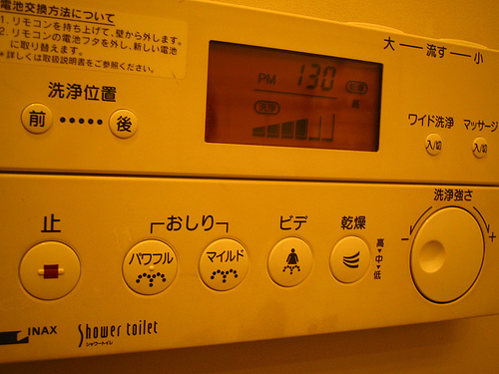
Component APIs Are Complicated
There is only one thing more painful than learning from
experience and that is not learning from experience.
– Archibald MacLeish

Slide 3
Temporal API Specifications
Legal interactions with a component
What methods could be called at every state
read,
write
finishConnect
finishConnect
read,
write
config
connect
close
0
1
2
3
4
5
close
java.nio.channels.SocketChannel (partial spec)

Slide 4
Applications
Program understanding
Regression
Deviant behaviors
Specs for verification
…

Slide 5
Mining Temporal Specifications
connect; read; close;
connect; write; close;
connect; write; write; close;
connect; close;
close
…
Real usage scenarios << Permitted scenarios
Client-side mining
Infer usage from existing clients using the component
Component-side mining
Infer usage from component implementation
Relies on error conditions in component implementation

Slide 6
Dynamic vs. Static Specification Mining
Dynamic
Mine specification from representative executions
Requires running the program (with varying inputs)
Incomplete coverage of behaviors
Static
Cover all client behaviors
Challenging
Our approach
Static client-side specification mining
Bad news: this is hard
Good news: we can still make it work

Slide 7
Example
How do I use a
java.nio.channels.SocketChannel?

Slide 8
void example() {
Collection<SocketChannel> chnls = createChannels();
for (SocketChannel sc : chnls){
sc.connect(new …);
while (!sc.finishConnect()) { /* ... wait for connection ... */ }
if (?) { receive(sc); } else { send(sc); }
}
closeAll(channels);
}
Collection<SocketChannel> createChannels() {
List<SocketChannel> list = new LinkedList<SocketChannel>();
list.add(createChannel(“ ", 80));
//… more channels added to list …
return list;
}
SocketChannel createChannel (String hostName, int port) {
SocketChannel sc = SocketChannel.open();
sc.configureBlocking(false);
return sc;
}

Slide 9
void example() {
Collection<SocketChannel> chnls = createChannels();
for (SocketChannel sc : chnls){
sc.connect(new …);
while (!sc.finishConnect()) { /* ... wait for connection ... */ }
if (?) { receive(sc); } else { send(sc); }
}
closeAll(channels);
}
Bad News
Interprocedural Flow
Flow Sensitivity
Context Sensitivity
Non-trivial aliasing
void receive(SocketChannel x) {
//…
FileOutputStream fos = new …;
ByteBuffer dst = …;
int numBytesRead = 0;
while (numBytesRead >= 0) {
numBytesRead = x.read(dst);
fos.write(dst.array());
}
fos.close();
}
void send(SocketChannel x) {
for (?) {
…
int numWritten = x.write(buf);
}
}
void closeAll (Collection<SocketChannel> chnls) {
for (SocketChannel sc : chnls) {
sc.close();
}
}

Slide 10
void example() {
Collection<SocketChannel> chnls = createChannels();
for (SocketChannel sc : chnls){
sc.connect(new …);
while (!sc.finishConnect()) { … }
if (?) { receive(sc); } else { send(sc); }
}
closeAll(channels);
}
SocketChannel createChannel (…)
{
SocketChannel sc = SocketChannel.open();
sc.configureBlocking(false);
return sc;
}
void receive(SocketChannel x) {
…
while (numBytesRead >= 0) {
numBytesRead = x.read(dst);
fos.write(dst.array());
} …
}}
sc=open()
cfg
sc.cfg
cfg
cnc
sc.cnc
cfg
cnc
fin
sc.fin
…
…
sc.fin
cfg
cnc
fin
…
fin
x.read
cfg
cnc
fin
…
fin
rd
…
…
cfg
cnc
fin
…
fin
rd
…
rd
x.read

Slide 11
SocketChannel Specification
read,
write
finishConnect
read,
write
config
connect
finishConnect
close
0
1
2
3
4
5
close
(Partial specification)

Slide 12
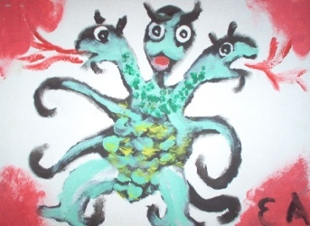
Challenges
Dynamically allocated objects
unbounded number of objects
aliasing
objects flow through complex heap-allocated data structures
➔ heap abstraction
Unbounded length of event sequences
event sequence observed for an object might be unbounded
➔ event sequence abstraction
Noise
analysis imprecision and/or incorrect client programs
➔ Noise reduction

Slide 13
Overview

Slide 14
Abstract Trace Collection
Abstract Interpretation
Abstract value
Heap abstraction: abstracts unbounded heap
Trace abstraction: abstracts unbounded sequences of operations
Initial heap abstraction
partition the heap into a fixed partition (based on allocation site)
fin
cfg
cnc
fin
cfg
cnc
fin
cfg
cnc
…
cfg
cnc
fin
AS1
AS2
AS3
AS1
AS2
AS3
AS3
AS2

Slide 15
void example() {
Collection<SocketChannel> chnls = createChannels();
for (SocketChannel sc : chnls){
sc.connect(new …);
while (!sc.finishConnect()) { … }
if (?) { receive(sc); } else { send(sc); }
}
closeAll(channels);
}
SocketChannel createChannel (…)
{
SocketChannel sc = SocketChannel.open(); // AS1
sc.configureBlocking(false);
return sc;
}
void receive(SocketChannel x) {
…
while (numBytesRead >= 0) {
numBytesRead = x.read(dst);
fos.write(dst.array());
} …
}}
sc=open()
<AS1, >
cfg
sc.cfg
<AS1, >
<AS1, >
cfg
cnc
cnc
sc.cnc
<AS1, >
<AS1, >
<AS1, >
…
…
[write, connect,
close, finCon,
read]
[write, connect,
close, finCon,
config, read]

Slide 16
Refined Heap Abstraction
Heap data for an “abstract object” o
unique = true
abstract value represents a single object
must = {x.f}
the access path x.f must point to o
mustNot = {y.g}
the access path y.g must not to point to o
…
Must points-to information allows strong updates
sc=open()
<AS1, must: { sc }, >
cfg
sc.cfg
<AS1, must : { sc }, >
<AS1, >

Slide 17
History Abstraction
cfg
cnc
fin
cfg
cnc
fin
<o₁, >
<allocated at AS₁, >
cfg
cnc
cfg
cnc
fin
…
fin
read
fin
<o₂, >
<AS1, >
…
?
cfg
cnc
fin
…
<allocated at AS_{k}, >
Abstract history
Automaton over-approximating unbounded event sequences
Quotient-based abstractions for history
Automata states which are equivalent w.r.t. a given equivalence relation R are merged

Slide 18
History Abstraction
Past-Future Abstraction
(q₁,q₂) ∈ R[k₁,k₂] if q₁ and q₂ share both an incoming sequence of length k₁ and an outgoing sequence of length k₂
a
a
a
a
a
c
a
c
a
c
a
c
c
b
b
b
b
c
c
c
Past 1 Examples
Future 1 Example

Slide 19
Abstract Semantics
Initial abstract history
empty sequence automaton
When an API method is invoked
history extended: append event and construct quotient
sc = open
cfg
sc.config
sc.connect
cfg
cnc
while (!sc.finCon) {
cfg
cnc
fin
fin
cfg
cfg
cnc
cnc
fin
fin
fin
fin
cfg
cnc
Past 1 equivalent
} //endof while
fin
cfg
cnc
fin

Slide 20
Are We Done?
Bounded is great, but not enough
Merge histories at control flow join points
Speed up convergence
Merge all histories that
have identical heap-data, and
satisfy a given merge criterion
Merge: union construction followed by quotient construction
if(?)
x.b()
x.a()
a
b
a
…

Slide 21
Example: Past Abstraction with Exterior Merge
fin
cfg
cnc
fin
cfg
cnc
fin
endof while
union
cfg
cnc
fin
fin
cfg
cnc
fin
quo
fin
cfg
cnc
fin

Slide 22
Recap: Abstraction Dimensions
Heap Abstraction
Base
APFocus (refined heap abstraction)
[write, connect,
close, finCon,
read]
[write, connect,
close, finCon,
read]
[write, connect,
close, finCon,
read]
[write, connect,
close, finCon,
config, read]
close
read
Past / Total
connect
6
[write, connect,
close, finCon,
config, read]
History Abstraction
config
0
1
close
0
1
0
1
2
read
[write, connect,
finCon, read]
connect
close
close
read
3
connect
4
6
[write, connect,
config, finCon,
read]
close
1
close
close
config
2
fincon
connect
read
0
1
close
write
Past / Exterior
connect
3
4
0
2
config
0
1
fincon
5
write
connect
connect
close
close
connect
5
write
close
write
Merge Criteria
Third dimension: different history abstraction, not shown here

Slide 23
Summarization Phase: Noise
Trace collection results
Real API
up
initS
up
sign
n
0
1
2
3
initS
up
up
verify
initV
up
verify
initV
k
0
1’
2’
3’
initV
up
initS
sign
initV
up
verify
1
0
1’
2’
3’
up
initV
verify
java.security.Signature
Analysis imprecision
Bugs in training corpus

Slide 24
Naïve Union
Trace collection results
Naïve Union
up
initS
up
sign
n
0
1
2
3
up
initS
up
sign
1
2
3
up
initS
initS
initV
up
verify
k
0
0
1’
2’
3’
initV
initV
initV
1’
up
2’
3’
up
verify
initV
up
verify
up
1
0
1’
2’
3’
initV
verify
verify
No noise reduction
Sound summary

Slide 25
Weighted Union
Trace collection results
Weighted Union
up
initS
up
sign
n
0
1
2
3
up
initS
up
sign
1
2
3
n
up
initS
initS
initV
up
verify
k
0
0
1’
2’
3’
initV
initV
initV
1’
up
2’
3’
k+1
up
verify
initV
up
verify
up
1
0
1’
2’
3’
initV
verify
verify
1
Label each transition with number of input automata that contain it
Transitions with weight < threshold are removed

Slide 26
Clustering
Trace collection results
Clustering
up
initS
up
sign
n
0
1
2
3
initS
up
sign
initS
0
1
2
3
n
initS
up
initV
up
verify
k
0
1’
2’
3’
1
initV
1
initS
1
up
initS
initV
up
verify
up
initV
up
verify
0
1’
2’
3’
k
1
0
1’
2’
3’
initV
initV
Automata partitioned into clusters of “similar” automata, each cluster summarized separately
Similarity = language inclusion

Slide 27
Experimental Results
Mined various APIs from a suite of benchmarks
APIs from Java libraries
java.security.Signature, java.security.KeyAgreement,…
Ganymed
Session, Connection, ConnectionManager,…
FlickrAPI
Photo, Auth, …
…

Slide 28
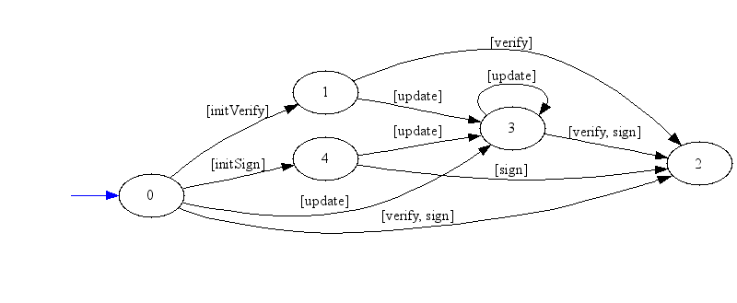
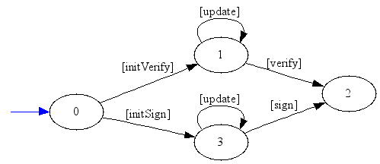
java.security.Signature
Base/Past/Total
Base/Past/Exterior
APFocus/Past/Exterior

Slide 29
Ganymed Session
Base/Past/Exterior
APFocus/Past/Exterior
(all results here are actual images produced by the tool)

Slide 30
Lessons from Experiments
Precise heap abstractions AND history abstractions needed
Pragmatics
Summaries other than union do not guarantee an over-approximation of behaviors, but still useful
with timeout, trace collection result is not an over-approximation, but still useful
Limitations
Too detailed results (print, println)
Scalability remains a challenge
Single object vs. multiple objects specs

Slide 31
Summary
Client-side specification mining
based on flow-sensitive, context-sensitive abstract interpretation
combined domain abstracting both aliasing and event sequences
Novel family of abstractions to represent unbounded event sequences
Novel summarization algorithms
Preliminary experimental results

Slide 32
The End
We are looking for interns in this area
Contact me: eyahav@us.ibm.com

Slide 33
Invited Questions
How do you get the API in the motivation slide from the example program you showed?
Can you give an example of the effect of past vs. future?
I didn’t get merge, can you show another example?
Can you say when the results are precise?
Can you say something more about experimental results?
Related Work?

Slide 34
API in motivation slide vs. one from example
Elements in list not known to be unique
connect can be repeated
close can be repeated
Read and write never happen together
Thus kept in separate parts of the automaton
This is not a bad result for an automated tool (and a single! example program)
All these would be “washed away” with a sufficient number of other examples
read,
write
finCon
config
connect
read,
write
close
finCon
0
1
2
3
4
5
close
close
connect
read
6
close
2
connect
read
close
3
4
config
fincon
0
1
write
connect
5
connect
write
close

Slide 35
Example: Past Abstraction with Exterior Merge
fin
cfg
cnc
fin
if(?)
then: while loop: x.read
else: while loop: x.write
fin
fin
cfg
cnc
fin
rd
cfg
cnc
fin
wr
fin
rd
fin
wr
cfg
cnc
fin
rd
cfg
cnc
fin
wr
endof for
fin
fin
rd
fin
wr
cfg
cnc
fin
cfg
cnc
fin
rd
cfg
cnc
fin
wr
No merge !

Slide 36
Example: Future Abstraction with Exterior Merge
endof for
fin
fin
rd
fin
wr
cfg
cnc
fin
cfg
cnc
fin
rd
cfg
cnc
fin
wr
merge
rd
fin
fin
rd
cfg
cnc
fin
fin
wr
wr

Slide 37
SocketChannel Specification
Past
Future
cnc
rd
rd
rd
fin
rd
cl
fin
cl
cl
fin
rd
cfg
cnc
fin
cl
cfg
cnc
fin
wr
cl
cnc
fin
fin
wr
cnc
wr
wr
wr
cl
cfg
In this example, different automata, but same language

Slide 38
Merge Criteria
a
b
a
b
a
union
union
a
a
b
b
a
quo
quo
a
a
b
b
a
Total Merge
Exterior Merge
(past 1 history abstraction)

Slide 39
Can you say when the results are precise?
when there exists an automaton such that the equivalence relation that we choose uniquely characterizes each states

Slide 40
Experimental Results

Slide 41
Japanese Toilet API
The two buttons linked together (next to the floating woman) are given the group label (well, "bottom" or "posterior"), one with the word "mild" and the other with "powerful." The icon on each button indicates a water jet.
I can't see the third character labeling the jog shuttle, but that appears to be a "flow" control for a water jet - not sure though.
There are several opportunities for mode errors here which (I hope) are mitigated by the LCD display: the button above the jog shuttle labeled "wide jet" is toggled on/off, and the "dryer" button cycles though three strengths. My experience with toilet UI (although not great) indicates that mode errors are a problem though. If that jet feels rather, er, surprising, a lack of mode data makes you reluctant to try to alter it...

Slide 42
(Some) Related Work
Dynamic
DAIKON (…)
Perracota (ICSE06)
DIDUCE (ICSE02)
Strauss (Ammons et. al. POPL02)
Whaley et. al. (ISSTA02)
…
Static
JIST (Alur et. al. POPL05)
Whaley et. al. (ISSTA02)
…

Slide 43
The Bigger Picture
Synthesis
Dynamic
(Today: 16:30)
Deriving concurrent GC algorithms
[PLDI06]
The Quality Virtual Machine
[in preparation]
Synth. concurrent GC algorithms
[PLDI07]
Software Quality
Deriving concurrent data-structures
[PLDI08]
Bacon, Rinetzky, Vechev
Arnold, Vechev
Static
Lightweight verification (typestate)
[ISSTA06, distinguished paper]
Specification mining
[ISSTA07, distinguished paper]
Modular Typestate
[POPL08]
…
Dor, Fink, Geay, Loginov, Pistoia, Ramalingam, Rinetzky, Shoham, Yorsh

Slide 44
Software Quality Costs
Phase | Defect Removal Cost Multiplier
Requirements | 1
Design | 3
Code,Unit Test | 5
Function/System Test | 12
User Acceptance Test | 32
Production | 95

