Slide 1
Program analysis & Synthesis
Lecture 10 – Synthesis from Examples
Eran Yahav

Slide 2
Previously
Abstraction-Guided Synthesis
changing the program to match an abstraction
transformations for sequential programs (equivalence)
transformations for concurrent programs
adding synchronization
program restriction

Slide 3
Today
Synthesis from examples
SMARTEdit
String processing in spreadsheet from examples
Acks
Some slide cannibalized from Tessa Lau
String processing in spreadsheets slides cannibalized from Sumit Gulwani

Slide 4
Programming by demonstration
Learn a program from examples
Main challenge: generalization
generalize from examples to something that is applicable in new situations
how can you generalize from a small number of examples?
how do you know that you’re done (generalized “enough”)?

Slide 5
Demo
SMARTedit

Slide 6
Programming by demonstration
Can be viewed as a search in the space of programs that are consistent with the given examples
how to construct the space of possible programs?
how to search this space efficiently?

Slide 7
Program synthesis with inter-disciplinary inspiration
Programming Languages
Design of an expressive language that can succinctly represent programs of interest and is amenable to learning
Machine Learning
Version space algebra for learning straight-line code
other techniques for conditions/loops
HCI
Input-output based interaction model

Slide 8
Version Spaces
Hypothesis space
set of functions from input domain to output domain
Version space
subspace of hypothesis space that are consistent with examples
partially ordered
generality ordering: h₁  h₂ iff h₂ covers more examples than h₁
(can also use other partial orders)

Slide 9
Version Spaces
A hypothesis h is consistent with a set of examples D iff h(x) = y for each example <x,y> ∈ D
The version space VS_{H,D} w.r.t. hypothesis space H and examples D, is the subset of hypotheses from H consistent with all examples in D

Slide 10
Version Spaces
when using generality ordering version space can be represented using just
the most general consistent hypotheses (least upper bound)
the most specific consistent hypotheses (greatest lower bound)

Slide 11
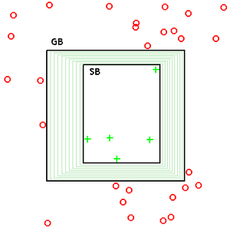
Version Spaces

Slide 12
Version Space Algebra
Union
VS_{H1,D}  VS_{H2,D} = VS_{H1  H2, D}
Join (what we would call reduced product)
D1 = sequence of examples over H1
D2 = sequence of examples over H2
VS_{H1,D1}  VS_{H2,D2} = { h1,h2 | h1 ∈ VS_{H1,D1}, h2 ∈ VS_{H2,D2,} C(h1,h2,D)}
C(h,D) – consistency predicate, true when h consistent in D
Independent join (product, no reduction)
D1,D2, h1 ∈H1, h2 ∈H2. C(h1,D1)  C(h2,D2)  C(h1,h2,D)

Slide 13
How SMARTedit works
Action is function : input state → output state
Editor state: text buffer, cursor position, etc.
Actions: move, select, delete, insert, cut, copy, paste
Given a state sequence, infer actions
Many actions may be consistent with one example
Move to next <!--
Delete to next
-->

Slide 14
What action?
what is the source location?
first location in text?
any location?
…
move?
what is the target location?
after “ple”?
after “sample”?
before “<!—”?
(4,19) ?
…
learned function has to be applicable in other settings

Slide 15
Editor State
=T,L,P,E
contiguous region of T representing the selection
contents of the text buffer
cursor location, a pair (row,column)
contents of the clipboard

Slide 16
Editor Transition (Action)
Editor state =T,L,P,E out of set of possible editor states 
Editor action is a function a:   

Slide 17
Editor Transition (Action)
T,(42,0),P,E
T,(43,0),P,E
“move to the next line”
consistent
“move to the beginning of line 43”
“move to the beginning of line 47”
inconsistent
“move to the end of line 41”

Slide 18
SMARTedit's version space
Action
Move
∪
Paste
Insert
Copy
Select
Cut
Delete
Action function maps from one state to another
Action version-space is a union of different kinds of actions

Slide 19
SMARTedit's version space
Action
Move
∪
Location
Delete
Location
Location
Express action functions in terms of locations

Slide 20
Location version space
Location
∪
Search
...
RowCol
Char
Offset
Col
f(x)=1
f(x)=2
f(x)=3
...
Row
Rectangle indicates atomic (leaf) version space
Location functions map from text state (buf, pos) to position

Slide 21
Move Actions
functions that change the location in the text
explicit target location in terms of row,column
relative location based on search
…
Move
Location
Search
∪
RowCol
...
Row
Col

Slide 22
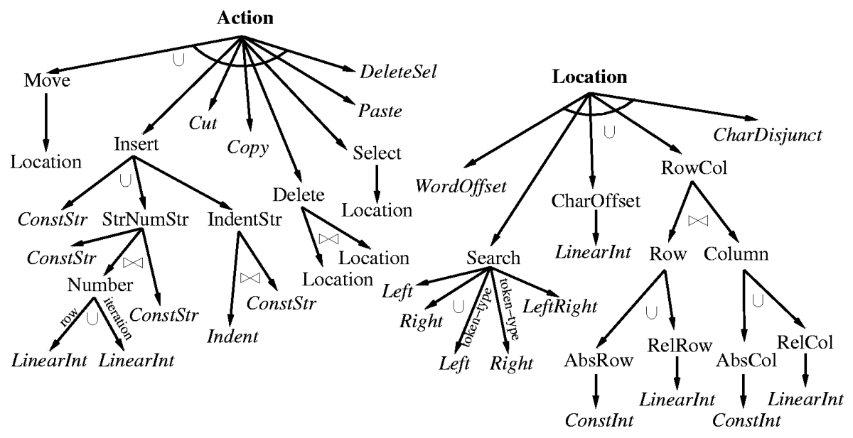
SMARTedit's version space
Notes:
Tree describes SMARTedit's version space
Top level: Program, composed of sequence of actions
Action can be one of...
Move to a Location, Insert a string, etc.
Italicized leaves
Three different operators: union, join, transformation

Slide 23
How does the system learn?
Update version space on new example
Remove inconsistent hypotheses
Prune away parts of the hierarchy
Execute version space for prediction
Give system current state
What state would the user produce next?

Slide 24
Updating the version space
Test consistency of example against entire version space
Quickly prune subtrees
Example:
Action
Move
∪
Paste
Insert
Copy
Select
Cut
Delete

Slide 25
Updating the version space
(1, 3)
<html>\n<!--...
Location
(2,0)
∪
(1,3)
RowCol
(2,0)
(1,3)
<html>\n<!--...
RightSearch
(2,0)
"a"
"b"
"<"
"<!"
"<!-"
...
1
Row
2
3
Col
0
f(x)=0
f(x)=1
f(x)=2
...
f(x)=x
f(x)=x+1
f(x)=x+2
...
g(x)=0
g(x)=1
g(x)=3
...
g(x)=x
g(x)=x+1
g(x)=x-3
...
Notes:
Location VS from SMARTedit
Red is input state, blue is output state

Slide 26
Executing the version space
?
(4, 5)
<html>\n<!--...
Location
(2,0), (2,2), (5,0), (5,2), (6,11)...
∪
(2,0),(2,2)
(5,0),(5,2)
(4,5)
RowCol
(4,5)
<html>\n<!--...
(5,0)
(6,11)
...
RightSearch
"<"
"<!"
"<!-"
"<!--"
...
4
Row
2,5
5
Col
0,2
f(x)=2
f(x)=x+1
g(x)=0
g(x)=x-3

Slide 27
Choosing between multiple outputs?
How to choose between possible outputs?
Associate probability with each hypothesis
Make better predictions
Introduce domain knowledge
Introduce probabilities at two points in hierarchy
Probability distribution over hypotheses at leaf nodes
Weights for each VS in a union

Slide 28
How does it really work?
what version spaces look like?
how do you represent them efficiently?
how do you update a version space?
how do you execute a version space?
dive deeper into string searching version spaces

Slide 29
String Searching
need to express locations relative to a string or a pattern
e.g., move the cursor to the next <!--
Let string X = x₁x₂ … x_{i}x_{i+1} … x_{n} be a string over some alphabet A
the dot  denotes position in the string
X.left = substring before the dot
X.right = substring after the dot

Slide 30
Right-search Hypotheses
right-search hypotheses output the next position such that a particular string is to its right
For each sequence of tokens S, the right-hypothesis of S, hright_{S} is a hypothesis that given an input state T,L,P,E outputs the first position Q > L such that S is a prefix of T.right(Q)

Slide 31
Example: Right-search Hypotheses
the user moves cursor the beginning of text occurrence “Candy”
5 right-hypotheses consistent with this action are:
hright_{Candy}
hright_{Cand}
hright_{Can}
hright_{Ca}
hright_{C}
how do you represent the right-search version space?

Slide 32
Representing right-search version space
define the partial order ^{right} to be the string prefix relation
hright_{s1} ^{right} hright_{s2} iff s1 is a proper prefix of s2
hright_{Candy} is the most general hypothesis for the previous example

Slide 33
Updating right-search version space
LUB S initialized to a token representing all strings of length K (greater than buffer size)
GLB C initialized to a token representing all strings of unit length
Given an example d = T,L,P,E  T,L’,P,E
cursor moved from position L to L’
T.right(L’) is the longest possible string the user could have been was searching
In moving from L to L’, user may have skipped over a prefix of T.right(L’) --- another occurrence --- such prefix is not the target hypothesis. Denote by S_{N} the longest prefix of T.right(L’) that begins in the range [L,L’)

Slide 34
Updating right-search version space
Given an example d = T,L,P,E  T,L’,P,E
T.right(L’) is the longest possible string the user could have been was searching
S_{N} the longest prefix of T.right(L’) that begins in the range [L,L’)
LUB = longest common prefix of LUB and T.right(L’)
GLB = longer string of GLB or S_{N}
if GLB is equal to or prefixed by LUB, version space collapses into the null set.

Slide 35
Example
speak spaceship
LUB = “spaceship”
GLB = “sp”
version space contains all prefixes of string in the LUB expect for the hypothesis “s” and “sp”

Slide 36
Executing right-search version space
the version space is equivalent to a set of strings
longest one is in the LUB
others are some prefixes of the LUB
execution applies each hypothesis to the input state and computes set of outputs
we don’t want to explicitly enumerate all hypotheses (substrings) in the space
leverage relationship between hypotheses

Slide 37
Executing right-search version space
executing single hypothesis
search for the next occurrence of a string relative to starting position L
for each hypothesis
find the next occurrence of the associated string in the text
output the location and the probability of the hypothesis
match longest string against every position of the text, look for partial matches
can probably exploit KMP string matching algorithm

Slide 38
Generalizing String Searching
can represent a string search version space as two offsets in a sequence of tokens
dependent on
dependently
positive
longest common prefix = “dependent”
negative
decline
VS = all prefixes of “dependent on” that are longer than 2 characters and shorter than 10 characters
dependent on

Slide 39
Generalizing String Searching
a hypothesis classifies positions as “true” when surrounding text matches the search string, “false” otherwise
can define generality order
h1  h2 iff set of positions covered by h1 is a subset of the set of positions covered by h2

Slide 40
Conjunctive String Searching
string conjunction for left and right search hypotheses
replay
Haifa, 32000
after “re” before “play”
after “Haifa,”
before zip code

Slide 41
Conjunctive String Searching
A display was rendered for re+play. We re+played it.
shortest consistent hypothesis in the left-search space
independent join can only represent rectangles…
must use dependent join (product)
can represent efficiently due to continuity
left
assume we added negative example:
deplane
r

r
replay
rep
e
p
l
a
y
right
ep
target hypothesis: replay
Can we use independent VSs – one for left (“re”) and one for right (“play”)?

Slide 42
Disjunctive String Searching
“move to the next occurrence of <UL> or <DL>”
difficult to learn
h = “disjunction of all observed examples” is always valid
example
search for the next occurrence of any single token from a set of “allowed’ tokens
positive example: token target location
negative examples: all tokens that were skipped to reach the target

Slide 43
Example

[abc…y]
[bcd…z]
…
…
…
[abc]
…
…
[cz]
[ab]
[bc]
[a]
[b]
[c]
…
[z]

example: user moves to “a”, skips “b” and “c”
VS: all charater-class hypotheses that contain “a” and do not contain “b” and “c”

Slide 44
Example
alphabet: a, b, c
text: abcbac
target hypothesis: {b,c} (move to next b or c)
d1 = abcbac  abcbac
no set containing “a” is consistent with d1
version space only contains {b} and {b,c}

Slide 45
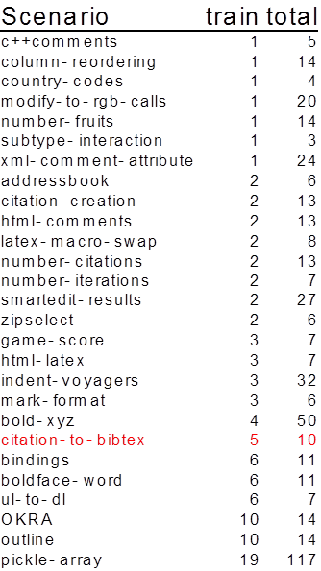
Experimental results
Very few examples needed!
Results indicate examples that must be demonstrated, out of total number of examples
Notes:
Walk through some of the scenarios, to get a feel for what kinds of things we can do

Slide 46
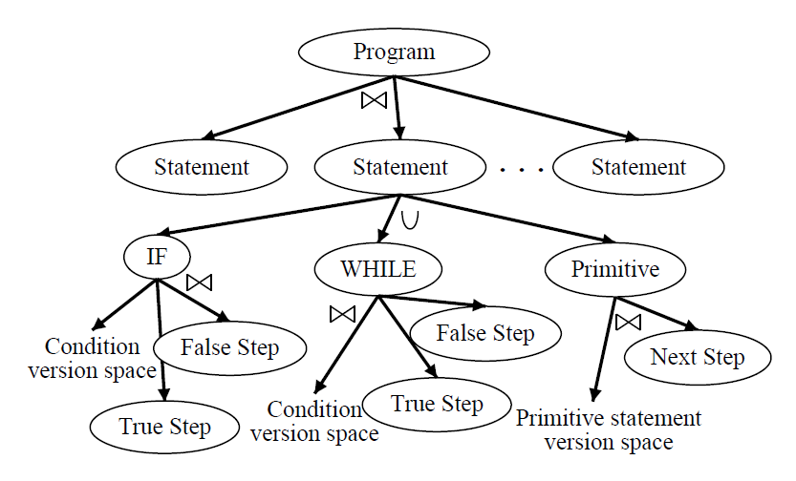
Learning Programs from Traces

Slide 47
Learning Programs from Traces
State configuration
incomplete: state contains subset of variables, some relevant variables hidden
variables observable: state includes all variables in the program
step observable: variable observable + unique identification of the step executed between every pair of states
fully observable: step observable + change predicates indicating which variables have changed

Slide 48
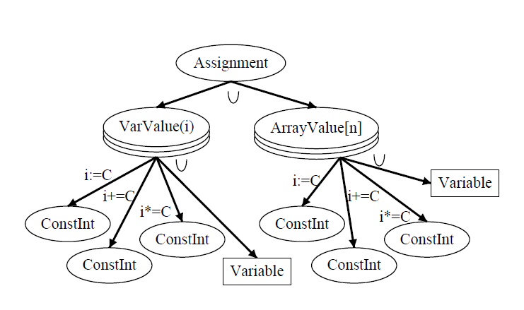
Primitive Statements

Slide 49
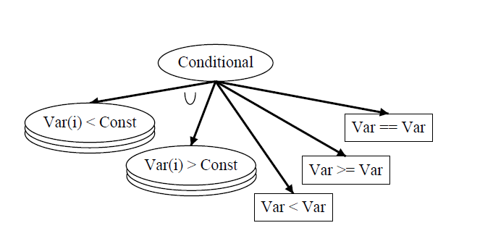
Conditionals

Slide 50
Automating String Processing in Spreadsheets using Input-Output Examples
Sumit Gulwani

Slide 51
Potential Consumers of Synthesis Technology
Algorithm
Designers
Software Developers
Most Useful Target
End-Users
Pyramid of Technology Users

Slide 52
Example
Input v₁ | Output
(425)-706-7709 | 425-706-7709
510.220.5586 | 510-220-5586
235 7654 | 425-235-7654
745-8139 | 425-745-8139
Format phone numbers

Slide 53
Language for Constructing Output Strings
Guarded Expression G := Switch((b₁,e₁), …, (b_{n},e_{n}))
String Expression e := Concatenate(f₁, …, f_{n})
Base Expression f := s // Constant String
| SubStr(v_{i}, p₁, p₂)
Index Expression p := k // Constant Integer
| Pos(r₁, r₂, k) // k^{th} position in string whose left/right side matches with r₁/r₂
Notation: SubStr2(v_{i},r,k)  SubsStr(v_{i},Pos(ε,r,k),Pos(r,ε,k))
Denotes k^{th} occurrence of regular expression r in v_{i}

Slide 54
Example: format phone numbers
Input v₁ | Output
(425)-706-7709 | 425-706-7709
510.220.5586 | 510-220-5586
235 7654 | 425-235-7654
745-8139 | 425-745-8139
Switch((b₁, e₁), (b₂, e₂)), where
b₁  Match(v₁,NumTok,3), b₂   Match(v₁,NumTok,3),
e₁  Concatenate(SubStr2(v₁,NumTok,1), ConstStr(“-”),
SubStr2(v₁,NumTok,2), ConstStr(“-”),
SubStr2(v₁,NumTok,3))
e₂  Concatenate(ConstStr(“425-”),SubStr2(v₁,NumTok,1),
ConstStr(“-”),SubStr2(v₁,NumTok,2))

Slide 55
Key Synthesis Idea: Divide and Conquer
Reduce the problem of synthesizing expressions into sub-problems of synthesizing sub-expressions.
Reduction requires computing all solutions for each of the sub-problems:
This also allows to rank various solutions and select the highest ranked solution at the top-level.
A challenge here is to efficiently represent, compute, and manipulate huge number of such solutions.
I will show three applications of this idea in the talk
Read the paper for more tricks!

Slide 56
Synthesizing Guarded Expression
Goal: Given input-output pairs: (i₁,o₁), (i₂,o₂), (i₃,o₃), (i₄,o₄), find P such that P(i₁)=o₁, P(i₂)=o₂, P(i₃)=o₃, P(i₄)=o₄.
Application #1: Reduce the problem of learning guarded expression P to the problem of learning string expressions for each input-output pair.
Algorithm:
1. Learn set S₁ of string expressions s.t. e in S₁, [[e]] i₁ = o₁. Similarly compute S₂, S₃, S₄. Let S = S₁ S₂S₃S₄.
2(a) If S ≠  then result is Switch((true,S)).

Slide 57
Example: Various choices for a String Expression
Input
Output
Constant
Constant
Constant

Slide 58
Synthesizing String Expressions
Number of all possible string expressions (that can construct a given output string o₁ from a given input string i₁) is exponential in size of output string.
# of substrings is just quadratic in size of output string!
We use a DAG based data-structure, and it supports efficient intersection operation!
Application #2: To represent/learn all string expressions, it suffices to represent/learn all base expressions for each substring of the output.

Slide 59
Example: Various choices for a SubStr Expression
Various ways to extract “706” from “425-706-7709”:
Chars after 1st hyphen and before 2nd hyphen.
Substr(v₁, Pos(HyphenTok,ε,1), Pos(ε,HyphenTok,2))
Chars from 2nd number and up to 2nd number.
Substr(v₁, Pos(ε,NumTok,2), Pos(NumTok,ε,2))
Chars from 2nd number and before 2nd hyphen.
Substr(v₁, Pos(ε,NumTok,2), Pos(ε,HyphenTok,2))
Chars from 1st hyphen and up to 2nd number.
Substr(v₁, Pos(HyphenTok,ε,1), Pos(ε,HyphenTok,2))


Slide 60
Synthesizing SubStr Expressions
The number of SubStr(v,p₁,p₂) expressions that can extract a given substring w from a given string v can be large!
This allows for representing and computing O(n₁*n₂) choices for SubStr using size/time O(n₁+n₂).
Application #3: To represent/learn all SubStr expressions, we can independently represent/learn all choices for each of the two index expressions.

Slide 61
Back to Synthesizing Guarded Expression
Goal: Given input-output pairs: (i₁,o₁), (i₂,o₂), (i₃,o₃), (i₄,o₄), find P such that P(i₁)=o₁, P(i₂)=o₂, P(i₃)=o₃, P(i₄)=o₄.
Algorithm:
Learn set S₁ of string expressions s.t. e in S₁, [[e]] i₁ = o₁. Similarly compute S₂, S₃, S₄. Let S = S₁S₂S₃ S₄.
2(a). If S ≠then result is Switch((true,S)).
2(b). Else find a smallest partition, say {S₁,S₂}, {S₃,S₄}, s.t. S₁S₂ ≠  and S₃S₄ ≠ .
3. Learn boolean formulas b₁, b₂ s.t.
b₁ maps i₁, i₂ to true and i₃, i₄ to false.
b₂ maps i₃, i₄ to true and i₁, i₂ to false.
4. Result is: Switch((b₁,S₁ S₂), (b₂,S₃  S₄))

Slide 62
Ranking Strategy
Prefer shorter programs
Fewer number of conditionals
Shorter string expression, regular expressions
Prefer programs with fewer constants

Slide 63
Recap
SMARTedit
learn programs (macros) for repetitive editing tasks
version space algebra to learn actions
String processing in spreadsheets
automate spreadsheet string transformations
version space algebra to learn actions
many other clever tricks to actually make it work

