Slide 1
Program analysis & Synthesis
Lecture 02 – Structural Operational Semantics (SOS)
Eran Yahav

Slide 2
Previously…
static analysis
over-approximation of program behavior
abstract interpretation
abstraction, transformers, fixed-point computation
examples of program analysis
parity abstraction
heap abstraction (shape analysis)
numerical abstractions
examples of program synthesis
optimized search in program space
program repair as a game
SKETCH
SMARTEdit

Slide 3
Today
What is the meaning of a program?
semantics
structural operational semantics
intro to abstract interpretation

Slide 4
What is the “meaning” of a program?
int foo(int a ) {
if( 0 < a < 5) c = 42 else c = 73;
return c;
}
int a() { printf(“a”); return 1; }
int b() { printf(“b”); return 2; }
int c() { printf(“c”); return 3; }
int sum(int x, int y, int z) { return x+y+z; }
void bar() {
printf(“%d, sum(a(),b(),c());
}

Slide 5
Semantics
“mathematical models of and methods for describing and reasoning about the behavior of programs”

Slide 6
Why Formal Semantics?
implementation-independent definition of a programming language
automatically generating interpreters (and some day maybe full fledged compilers)
verification and debugging
if you don’t know what it does, how do you know its incorrect?

Slide 7
Different Approaches
Denotational Semantics
define an input/output relation that assigns meaning to each construct (denotation)
Structural Operational Semantics
define a transition system, transition relation describes evaluation steps of a program
Axiomatic Semantics
define the effect of each construct on logical statements about program state (assertions)

Slide 8
Denotational Semantics
int double1(int x) {
int t = 0;
t = t + x;
t = t + x;
return t;
}
int double2(int x) {
int t = 2*x;
return t;
}
λx.2*x
λx.2*x

Slide 9
Operational Semantics
int double1(int x) {
int t = 0;
t = t + x;
t = t + x;
return t;
}
int double2(int x) {
int t = 2*x;
return t;
}
x  2
[t  0, x  2]
[t  2, x  2]
[t  4, x  2]
[t  4, x  2]
[t  4, x  2]

Slide 10
Axiomatic Semantics
int double1(int x) {
{ x = x₀ }
int t = 0;
{ x = x₀ ∧ t = 0 }
t = t + x;
{ x = x₀ ∧ t = x₀ }
t = t + x;
{ x = x₀ ∧ t = 2*x₀ }
return t;
}
int double2(int x) {
{ x = x₀ }
int t = 2*x;
{ x = x₀ ∧ t = 2*x₀ }
return t;
}

Slide 11
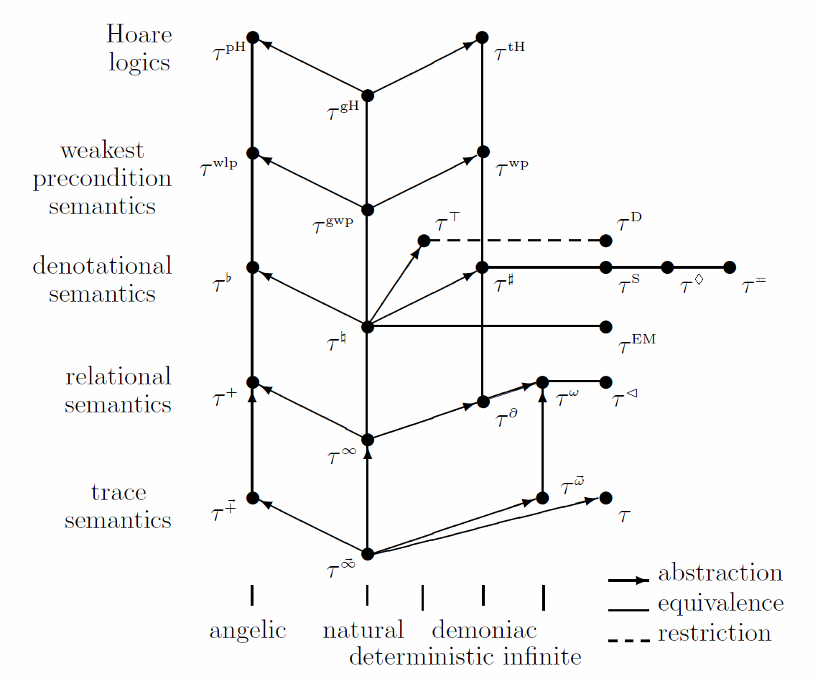
Relating Semantics

Slide 12
What is the “meaning” of this program?
[y := x]¹;
[z := 1]²;
while [y > 0]³ (
[z := z * y]⁴;
[y := y − 1]⁵;
)
[y := 0]⁶

Slide 13
what is the “meaning” of an arithmetic expression?
z * y
y – 1
First: syntax of simple arithmetic expressions
For now, assume no variables
a ::= n | a1 + a2 | a1 – a2 | a1 * a2 | (a1)

Slide 14
Structural Operational Semantics
Defines a transition system (,,T)
configurations : snapshots of current state of the program
transitions   : steps between configurations
final configurations T  
σ₁
σ₂
 = { σ_{1,} σ_{2,} σ_{3,} σ₄ }
 = { (σ_{1,}σ₂), (σ_{1,}σ₄), (σ_{2,}σ₃) }
σ₄
σ₃
T = { σ_{3,} σ₄ }

Slide 15
Structural Operational Semantics Useful Notations
We write σσ’ when (σ,σ’) ∈ 
* denotes the reflexive transitive closure of the relation 
σ*σ’ when there is a sequence σ=σ₀  σ₁  … σ_{n} = σ’ for some n ≥ 0

Slide 16
Big-step vs. Small-step
Big-step
σ  σ’ describes the entire computation
σ’ is always a terminal configuration
Small-step
σ  σ’ describes a single step of a larger computation
σ’ need not be a terminal configuration
pros/cons to each
big-step hard in the presence of concurrency

Slide 17
Simple Arithmetic Expressions (big step semantics)
premises
side condition
a1  v1 a2  v2
[Plus]
where v = v1 + v2
a1 + v1  v
conclusion
a  v means “expression a evaluates to the value v”
a ∈AExp , v ∈ Z

Slide 18
Simple Arithmetic Expressions (big step semantics)
a1  v1 a2  v2
[Plus]
where v = v1 + v2
a1 + v1  v
a1  v1 a2  v2
[Minus]
where v = v1 - v2
a1 - v1  v
a1  v1 a2  v2
[Mult]
where v = v1 * v2
a1 * v1  v
a1  v1
[Paren]
(a1)  v
[Num] n  v if N←n→ = v

Slide 19
Simple Arithmetic Expressions (big step semantics)
Transition system (,,T)
configurations  = AExp  Z
transitions   : defined by the rules on the previous slide
final configurations T = Z
Transitions are syntax directed

Slide 20
Derivation Tree
show that (2+4)*(4+3)  42
2  2
4  4
4  4
3  3
2  2 4  4
4  4 3  3
2 + 4  6
4 + 3  7
2 + 4  6
4 + 3  7
(2 + 4)  6
(4 + 3)  7
(2+4)  6 (4 + 3)  7
(2+4)*(4 + 3)  42

Slide 21
Derivation Tree
2  2 4  4
4  4 3  3
2 + 4  6
4 + 3  7
(2 + 4)  6
(4 + 3)  7
(2+4)*(4 + 3)  42

Slide 22
Simple Arithmetic Expressions (small step semantics)
a1  a1’
[Plus-1]
a1 + a2 a1’ + a2
a2 a2’
[Plus-2]
a1 + a2 a1 + a2’
[Plus-3] v1 + v2 v where v = v1+ v2
intermediate values
intermediate configurations

Slide 23
Determinacy
We would like the big-step semantics of arithmetic expressions to be deterministic
a  v1 and a  v2 then v1 = v2
induction on the height of the derivation tree (“transition induction”)
show that rules for roots are deterministic
show that transition rules are deterministic

Slide 24
Determinacy
Is the small-step semantics of arithmetic expressions deterministic?
we want
if a  v1 and a  v2 then v1 = v2
but we have, for example
2 +3  2 + 3
2 + 3  2 + 3

Slide 25
Small Step and Big Step
small step
σ0  σ1
σ1  σ2
σ2  σ3
big step
σ0  σ3

Slide 26
The WHILE Language: Syntax
Var set of variables
Lab set of labels
Op_{a} arithmetic operators
Op_{b} boolean operators
Op_{r} relational operators
A  AExp arithmetic expressions
B  BExp boolean expressions
S  Stmt statements
a ::= x | n | a1 op_{a} a2
b ::= true | false | not b | b1 op_{b} b2 | a1 op_{r} a2
S ::= [x := a]^{lab}
| [skip]^{lab}
| S1;S2 | if [b]^{lab} then S1 else S2
| while [b]^{lab} do S
(We are going to abuse syntax later for readability)

Slide 27
The WHILE Language: Structural Operational Semantics
❒  State = Var  Z
Configuration:
<S, >
❒ for terminal configuration
Transitions:
<S, >  <S’, ’>
<S, >  ’
Both the statement that remains to be executed, and the state, can change

Slide 28
The WHILE Language: Structural Operational Semantics
Transition system (,,T)
configurations  = (Stmt  State)  State
transitions   
final configurations T = State

Slide 29
Arithmetic Expressions
A: AExp  (State  Z)
A←x→ = (x)
A←n→ = N←n→
A←a1 op a2→ = A←a1→ op A←a2→

Slide 30
Boolean Expressions
B: BExp  (State  { true, false} )
B←not b→ = B←b→
B←b1 op_{b} b2→ = B←b1→ op_{b} B←b2→
B←a1 op_{r} a2→ = A←a1→ op_{r} A←a2→

Slide 31
The WHILE Language: Structural Operational Semantics
[ass]
<[x := a]^{lab}, >  [x A←a→]
[skip]
<[skip]^{lab},  > 
<S₁ ,  > <S’₁, ’>
[seq₁]
<S₁; S₂,  > < S’₁; S₂, ’>
<S₁ ,  > ’
[seq₂]
<S₁; S₂,  > < S₂, ’>
(Table 2.6 from PPA)

Slide 32
The WHILE Language: Structural Operational Semantics
[if₁]
<if [b]^{lab} then S1 else S2,  >  <S1, > if B←b→  = true
[if₂]
<if [b]^{lab} then S1 else S2,  >  <S2, > if B←b→  = false
[wh₁]
<while [b]^{lab} do S,  >  <(S; while [b]^{lab} do S), > if B←b→  = true
[wh₁]
<while [b]^{lab} do S,  >   if B←b→  = false
(Table 2.6 from PPA)

Slide 33
Derivation Sequences
Finite derivation sequence
A sequence <S₀, ₀>… _{n}
<S_{i}, _{i}> <S_{i+1}, _{i+1}>
_{n} terminal configuration
Infinite derivation sequence
A sequence <S₀, ₀>…
<S_{i}, _{i}> <S_{i+1}, _{i+1}>

Slide 34
Termination in small-step semantics
while [0 = 0]¹ (
[skip]²;
)
< while [0 = 0]¹ ([skip]²),σ > 
< [skip]²;while [0 = 0]¹ ([skip]²), σ > 
< while [0 = 0]¹ ([skip]²),σ > 
< [skip]²;while [0 = 0]¹ ([skip]²), σ >  …

Slide 35
Termination in small-step semantics
We say that S terminates from a start state σ when there exists a state σ’ such that <S,σ> * σ’

Slide 36
Termination in big-step semantics
while [0 = 0]¹ (
[skip]²;
)
what would be the transition in the big-step semantics for this example?

Slide 37
Semantic Equivalence
formal semantics enables us to reason about programs and their equivalence
S1 and S2 are semantically equivalent when
for all σ and σ’ <S1,σ> * σ’ iff <S2,σ> * σ’
We write S1 ∼ S2 when S1 and S2 are semantically equivalent

Slide 38
Abnormal Termination
add a statement abort for aborting execution
in the big-step semantics
while (0=0) skip; ∼ abort
big-step semantics does not distinguish between abnormal termination and infinite-loops
in the small-step semantics
while (0=0) skip; ∼ abort
but we can distinguish the cases if we look at the transitions
<abort,σ> 0 <abort,σ>
infinite trace of skips

Slide 39
Nondeterminism big-step semantics
new language construct s1 OR s2
<S₁ ,  >  ’
[OR1-BSS]
<S₁ OR S₂,  >  ’
<S₂ ,  >  ’
[OR2-BSS]
<S₁ OR S₂,  >  ’

Slide 40
Nondeterminism small-step semantics
[OR1-SSS]
<S₁ OR S₂,  >  <S1,>
[OR1-SSS]
<S₁ OR S₂,  >  <S2,>

Slide 41
Nondeterminism
(x = 1) OR while(0=0) skip;
big-step semantics suppresses infinite loops
small step semantics has the infinite sequence created by picking the while
<(x = 1) OR while(0=0) skip;,σ>  <while(0=0) skip;,σ>  …

Slide 42
What is the “meaning” of this program?
[y := x]¹;
[z := 1]²;
while [y > 0]³ (
[z := z * y]⁴;
[y := y − 1]⁵;
)
[y := 0]⁶
now we can answer this question using derivation sequences

Slide 43
Example of Derivation Sequence
[y := x]¹;
[z := 1]²;
while [y > 0]³ (
[z := z * y]⁴;
[y := y − 1]⁵;
)
[y := 0]⁶
< [y := x]¹;[z := 1]²;while [y > 0]³ ([z := z * y]⁴;[y := y − 1]⁵;)[y := 0]⁶,{ x42, y0, z0 } > 
< [z := 1]²;while [y > 0]³ ([z := z * y]⁴;[y := y − 1]⁵;)[y := 0]⁶,{ x42, y42, z0 } > 
< while [y > 0]³ ([z := z * y]⁴;[y := y − 1]⁵;)[y := 0]⁶,{ x42, y42, z1 } > 
< ([z := z * y]⁴;[y := y − 1]⁵;);while [y > 0]³ ([z := z * y]⁴;[y := y − 1]⁵;)[y := 0]⁶,{ x42, y42, z1 }> …

Slide 44
Traces
< [y := x]¹;[z := 1]²;while [y > 0]³ ([z := z * y]⁴;[y := y − 1]⁵;)[y := 0]⁶,{ x42, y0, z0 } > 
< [z := 1]²;while [y > 0]³ ([z := z * y]⁴;[y := y − 1]⁵;)[y := 0]⁶,{ x42, y42, z0 } > 
< while [y > 0]³ ([z := z * y]⁴;[y := y − 1]⁵;)[y := 0]⁶,{ x42, y42, z1 } > 
< ([z := z * y]⁴;[y := y − 1]⁵;);while [y > 0]³ ([z := z * y]⁴;[y := y − 1]⁵;)[y := 0]⁶,{ x42, y42, z1 }> …
[y := x]¹
< [y := x]¹;[z := 1]²;while [y > 0]³ ([z := z * y]⁴;[y := y − 1]⁵;)[y := 0]⁶,{ x42, y0, z0 } > 
< [z := 1]²;while [y > 0]³ ([z := z * y]⁴;[y := y − 1]⁵;)[y := 0]⁶,{ x42, y42, z0 } > 
< while [y > 0]³ ([z := z * y]⁴;[y := y − 1]⁵;)[y := 0]⁶,{ x42, y42, z1 } > 
< ([z := z * y]⁴;[y := y − 1]⁵;);while [y > 0]³ ([z := z * y]⁴;[y := y − 1]⁵;)[y := 0]⁶,{ x42, y42, z1 }> …
[z := 1]²
[y > 0]³

Slide 45
Traces
[y := x]¹
< [y := x]¹;[z := 1]²;while [y > 0]³ ([z := z * y]⁴;[y := y − 1]⁵;)[y := 0]⁶,{ x42, y0, z0 } > 
< [z := 1]²;while [y > 0]³ ([z := z * y]⁴;[y := y − 1]⁵;)[y := 0]⁶,{ x42, y42, z0 } > 
< while [y > 0]³ ([z := z * y]⁴;[y := y − 1]⁵;)[y := 0]⁶,{ x42, y42, z1 } > 
< ([z := z * y]⁴;[y := y − 1]⁵;);while [y > 0]³ ([z := z * y]⁴;[y := y − 1]⁵;)[y := 0]⁶,{ x42, y42, z1 }> …
[z := 1]²
[y > 0]³
[y := x]¹
< 1,{ x42, y0, z0 } > 
< 2,{ x42, y42, z0 } > 
< 3,{ x42, y42, z1 } > 
< 4,{ x42, y42, z1 }> …
[z := 1]²
[y > 0]³

Slide 46
Traces
[y := x]¹
< 1,{ x42, y0, z0 } > 
< 2,{ x42, y42, z0 } > 
< 3,{ x42, y42, z1 } > 
< 4,{ x42, y42, z1 }> …
[z := 1]²
[y > 0]³

Slide 47
Trace Semantics
[y := x]¹
[z := 1]²
[y := x]¹;
[z := 1]²;
while [y > 0]³ (
[z := z * y]⁴;
[y := y − 1]⁵;
)
[y := 0]⁶
< 1,{ x42, y0, z0 } >  < 2,{ x42, y42, z0 } > 
< 3,{ x42, y42, z1 } >  < 4,{ x42, y42, z1 }> …
[y > 0]³
[y := x]¹
[z := 1]²
< 1,{ x73, y0, z0 } >  < 2,{ x73, y73, z0 } > 
< 3,{ x73, y73, z1 } >  < 4,{ x73, y73, z1 }> …
[y > 0]³
…
In the beginning, there was the trace semantics…
note that input (x) can be anything
clearly, the trace semantics is not computable

Slide 48
Abstract Interpretation
abstract state
abstract state
σ
←S→
σ’
abstract


C’’

C
←S→
C’
concrete
set of states
set of states

Slide 49
Dataflow Analysis
{ (x,?), (y,?), (z,?) }
1: y := x;
2: z := 1;
3: while y > 0 {
4: z := z * y;
5: y := y − 1
}
6: y := 0
{ (x,?), (y,1), (z,?) }
{ (x,?), (y,1), (z,2) }
{ (x,?), (y,1), (z,2) }
{ (x,?), (y,?), (z,4) }
{ (x,?), (y,5), (z,4) }
{ (x,?), (y,1), (z,2) }
{ (x,?), (y,?), (z,?) }
Reaching Definitions
The assignment lab: var := exp reaches lab’ if there is an execution where var was last assigned at lab
(adapted from Nielson, Nielson & Hankin)

Slide 50
Dataflow Analysis
{ (x,?), (y,?), (z,?) }
1: y := x;
2: z := 1;
3: while y > 0 {
4: z := z * y;
5: y := y − 1
}
6: y := 0
{ (x,?), (y,1), (z,?) }
{ (x,?), (y,1), (z,2), (y,5), (z,4) }
{ (x,?), (y,1), (z,2), (y,5), (z,4) }
{ (x,?), (y,?), (z,4), (y,5) }
{ (x,?), (y,5), (z,4) }
{ (x,?), (y,1), (z,2), (y,5), (z,4) }
{ (x,?), (y,6), (z,2), (z,4) }
Reaching Definitions
The assignment lab: var := exp reaches lab’ if there is an execution where var was last assigned at lab
(adapted from Nielson, Nielson & Hankin)

Slide 51
Dataflow Analysis
Build control-flow graph
Assign transfer functions
Compute fixed point

Slide 52
Control-Flow Graph
1: y := x;
2: z := 1;
3: while y > 0 {
4: z := z * y;
5: y := y − 1
}
6: y := 0
1: y:=x
2: z:=1
3: y > 0
6: y:=0
4: z=z*y
5: y=y-1

Slide 53
Transfer Functions
1: y:=x
in(1) = { (x,?), (y,?), (z,?) }
in(2) = out(1)
in(3) = out(2) U out(5)
in(4) = out(3)
in(5) = out(4)
in(6) = out(3)
out(1) = in(1) \ { (y,l) | l ∈ Lab } U { (y,1) }
2: z:=1
out(2) = in(2) \ { (z,l) | l ∈ Lab } U { (z,2) }
3: y > 0
out(3) = in(3)
4: z=z*y
6: y:=0
out(6) = in(6) \ { (y,l) | l ∈ Lab } U { (y,6) }
out(4) = in(4) \ { (z,l) | l ∈ Lab } U { (z,4) }
5: y=y-1
out(5) = in(5) \ { (y,l) | l ∈ Lab } U { (y,5) }

Slide 54
System of Equations
in(1) = { (x,?), (y,?), (z,?) }
in(2) = out(1)
in(3) = out(2) U out(5)
in(4) = out(3)
in(5) = out(4)
In(6) = out(3)
out(1) = in(1) \ { (y,l) | l ∈ Lab } U { (y,1) }
out(2) = in(2) \ { (z,l) | l ∈ Lab } U { (z,2) }
out(3) = in(3)
out(4) = in(4) \ { (z,l) | l ∈ Lab } U { (z,4) }
out(5) = in(5) \ { (y,l) | l ∈ Lab } U { (y,5) }
out(6) = in(6) \ { (y,l) | l ∈ Lab } U { (y,6) }
F: ((Var x Lab) )¹² → ((Var x Lab) )¹²

Slide 55
Least Fixed Point
We will see later why it exists
For now, mostly informally…
F: ((Var x Lab) )¹² → ((Var x Lab) )¹²
RD  RD’ when i: RD(i)  RD’(i)
F is monotone:
RD  RD’ implies that F(RD)  F(RD’)
RD∅ = (∅, ∅,…,∅)
F(RD∅), F(F(RD∅) , F(F(F(RD∅)), … F^{n}(RD∅)
F^{n+1}(RD∅) = F^{n}(RD∅)
F^{n}(RD∅)

…
F(F(RD∅))

F(RD∅)

RD∅

Slide 56
Things that Should Trouble You
How did we get the transfer functions?
How do we know these transfer functions are safe (conservative)?
How do we know that these transfer functions are optimal?

Slide 57
References
“Transitions and Trees” / Huttel
“Principles of Program Analysis” / Nielson, Nielson, and Hankin

