Slide 1

Polynomially Homomorphic Signatures
Dan Boneh
Stanford University
Joint work with David Freeman

Slide 2
Recall: fully homomorphic encryption
server
PK, E_{pk}[x]
E_{pk}[x]
E_{pk}[ f(x) ]
E_{pk}[ f(x) ]
For any function f [G’09, SV’10, vDGHV’10, …]
Lots of excitement around this concept (FHE)

Slide 3
Can we do the same for signatures?
untrusted server
u₁, 91.0, σ₁
“grades”, f:X^{k}→X
(e.g. mean)
signed
grades
u₂, 73.0, σ₂
SK
87.3, σ_{f}
u_{k}, 84.0, σ_{k}
σ_{f} = sig on ‹ “grades”, 91.0, u_{i} ›
σ = sig on ‹ “grades”, 87.3, “f” ›
σ_{f} authenticates x = f(x₁,…,x_{k}) and f
Can further compute on σ_{f}: σ_{gf} sig on (t, g(f(m)), “g°f” )

Slide 4

more generally: Predicate Signatures [ABCHSW’10]
Homomorphic signature for relation P ⊆ 2^{M} × M’
S can generate Alice’s sig on P-approved msgs. and nothing else
Derived sigs should be “short” , “private” , and composable
m₁, sign(sk,m₁)
m_{k}, sign(sk,m_{k})
(m , sig. on m)
⇔
P*( (m₁, …, m_{k}), m )
S
SK

Slide 5
Unifies three lines of research
Quoting/Redaction [JMSW’02, …] :
given (document, sig) anyone can derive a
signature on substring or subset of document
Linearly homomorphic (network coding) [KFM’04,…] :
given signatures on vectors v₁, …, v_{k} in F^{n}
anyone can derive a sig on linear combination
Transitive signatures [MR’02,…] :
given sigs on nodes and edges of graph G=(V,E) anyone can derive sig on (u,v) in V² if there is a path from u to v in G

Slide 6
Back to Homomorphic Sigs: Syntax
setup( 1^{n}, k ): n=(sec. param), k=(max data size)
→ signing key sk, public key pk
function family f: Y ⟶ X ∈ F
sign( sk, m ): output ( σ, random tag t )
eval( pk, t, f, sig σ on m ): ⟶ sig σ’ on (t, f(m), “f”)
verify( pk, (t, m, “f”), σ): ⟶ 1 or 0
to verify fresh sig use “id” function: f(x) = x

Slide 7
Desirable properties: data m with tag t
Certified computation (existential unforgeability):
given (σ_{i}, t_{i})⟵Sign( sk, {m_{i,1} ... m_{i,k}} ) for many i,
can’t compute σ’ on (t_{i}, x, “f”) for x ≠ f(m_{i,1} … m_{i,k})
Private: Let σ’ be derived sig on (t, x, “f”) for x = f(m).
given x and f, sig. σ’ reveals “no other info” about m
Short: the length of σ’ is at most ( log |m| ) × λ^{O(1)}
Composable

Slide 8
Privacy: two definitions
Weak context hiding [BBD…’10] (a la witness indistinguishability):
derived sig. does not help adv. distinguish compatible data sets
f(m₁) = f(m₂) ⇒ derived sig on f(m₁) ≈ derived sig on f(m₂)
Strong context hiding [MR’02, ABCHSW’10] (a la zero knowledge):
derived sigs look like fresh sigs (given sk and original sigs)
∀m: ( sk, sign(sk, m) , sign(sk, f(m) ) ≈
( sk, sign(sk, m) , eval( pk, ⋅, f, sig σ on m ) )
Key difference: original sigs remain hidden in weak context hiding
(in both defs adv. can be given the secret key)

Slide 9
Applications
  Authenticated statistics: average, variance, …
  Data mining: signed decision trees (ID3), signed SVM, …
  Least squares
saturn
jupiter
log (orbit period)
earth
mars
venus
log (axis of orbit)

Slide 10
Signed least squares (ex: y = ax+b)
Consider data set { (x_{i}, y_{i}) } _{i=1,…k} of integers.
Then:
a = f(x , y) / h(x, y) and b = g(x, y) / h(x, y)
where f, g, h are cubic integer polynomials
Using a cubic homomorphic scheme:
signed x₁, …, x_{k}, y₁, …, y_{k} signed f(x,y), g(x,y), h(x,y)
⇒

Slide 11
Constructions

Slide 12
Homomorphic systems
 | Encryption | Signatures
Linear functions | Large p: [P’99,…] Small p: [GM’82,…] | [KFM’04,CJL’06,BFKW’09] [BF’10, BF’11]
Polynomials | quadratic: [BGN’05, GHV’10] small degree: [G’09] | [BF’11] (small degree)
Poly-size circuits | [G’09, vDGHV’10, SV’10] | ????

Slide 13
Homomorphic systems
 | Encryption | Signatures
Linear functions | Large p: [P’99,…] Small p: [GM’82,…] | [KFM’04,CJL’06,BFKW’09] [BF’10, BF’11]
Polynomials | quadratic: [BGN’05, GHV’10] small degree: [G’09] | [BF’11] (small degree)
Poly-size circuits | [G’09, vDGHV’10, SV’10] | ????

Slide 14
Homomorphic systems
 | Encryption | Signatures
Linear functions | Large p: [P’99,…] Small p: [GM’82,…] | [KFM’04,CJL’06,BFKW’09] [BF’10, BF’11]
Polynomials | quadratic: [BGN’05, GHV’10] small degree: [G’09] | [BF’11] (small degree)
Poly-size circuits | [G’09, …] | ????

Slide 15
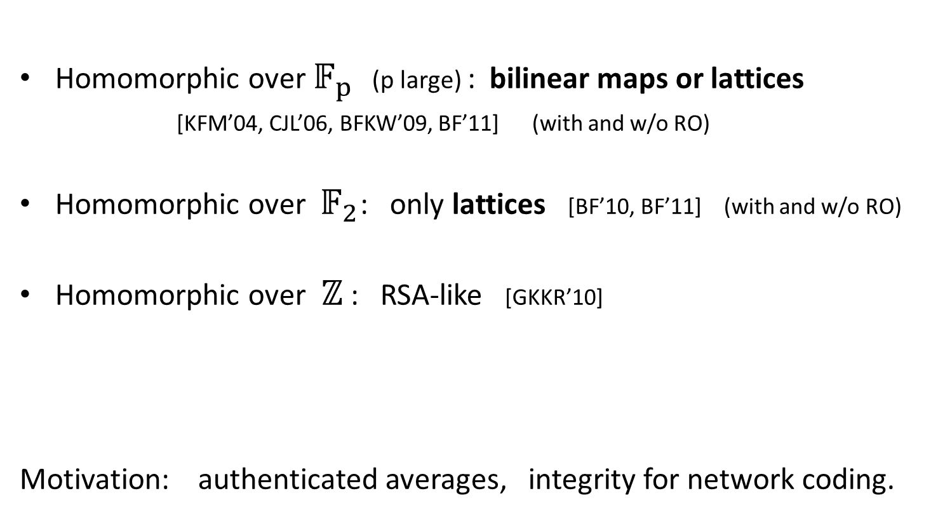
Linearly homomorphis sigs: options
Homomorphic over $𝔽_{p}$ (p large) : bilinear maps or lattices [KFM’04, CJL’06, BFKW’09, BF’11] (with and w/o RO)
Homomorphic over $𝔽_{2}$: only lattices [BF’10, BF’11] (with and w/o RO)
Homomorphic over $ℤ$ : RSA-like [GKKR’10]
Motivation: authenticated averages, integrity for network coding.

Slide 16
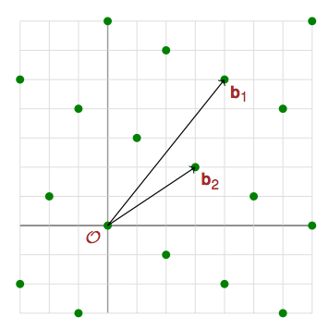

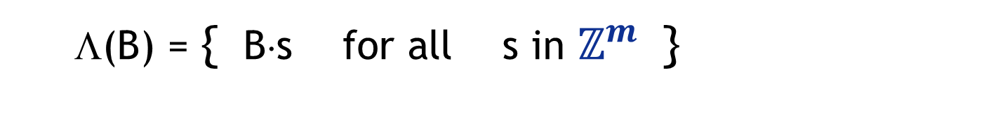
Lattices in $ℤ^{m}$ (e.g. m=512)
Λ(B) = { B⋅s for all s in $ℤ^{m}$ }
B =
…
b₁
b_{m}

Slide 17

Cosets of a lattice
A hard problem (ISIS):
given Λ and u ∈$ℤ^{m}$ find short v ∈ Λ+u
Fact [GPV’08] : ISIS has a trapdoor
“short” basis of Λ⊥ ⇒
can sample ISIS solution for all u ∈${ ℤ}^{m}$

Slide 18
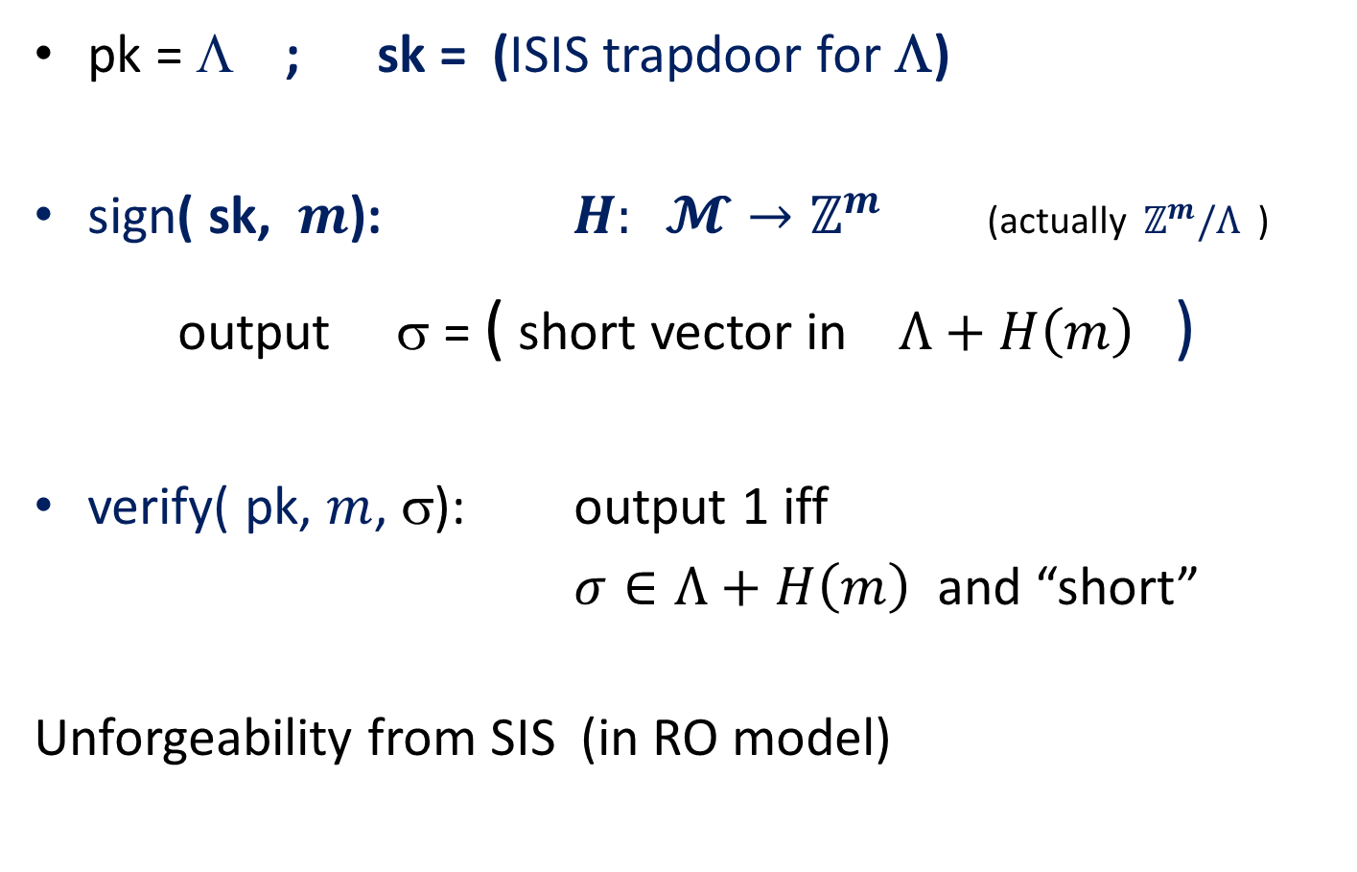
Lattice-based signatures [GPV’08]
pk = Λ ; sk = (ISIS trapdoor for Λ)
sign( sk, $m$): $H: 𝓜→ℤ^{m}$ (actually $ℤ^{m}/Λ$ )
  output σ = ( short vector in $Λ+H\left(m\right)$ )
verify( pk, $m$, σ): output 1 iff
$σ∈Λ+H\left(m\right)$ and “short”
Unforgeability from SIS (in RO model)

Slide 19


A linear lattice signature system
(the intersection method)
pk = Λ₁, Λ₂ $⊆ℤ^{m}$ ; sk = (trapdoor for $Λ_{1}∩Λ_{2}$)
Let $H: \text{tag}×ℤ→ℤ^{m}$
sign( sk, $\left(t, m_{i}, i\right)$ ): output short $σ∈ℤ^{m}$ s.t.
  $σ=m_{i} \left(\text{mod} Λ_{1}\right)$ (data)
  $σ= H\left(t,i\right) \text{(}\text{mod} Λ_{2})$ (function)
Message space is m_{i} ∈ $ℤ^{m}/Λ_{1}$ :
$Λ_{1}={\left(2ℤ\right)}^{m}$ ⇒ m_{i} ∈ ${\left(𝔽_{2}\right)}^{m}$
$$Λ_{1}+Λ_{2}=ℤ^{m}$$

Slide 20
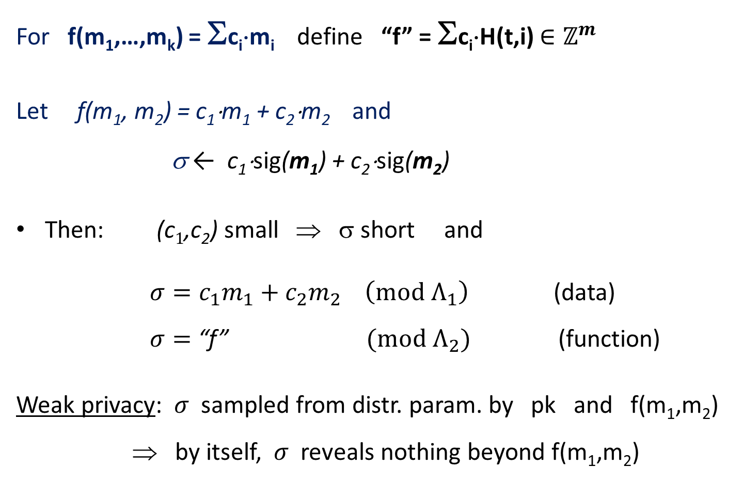
Homomorphic property
  For f(m₁,…,m_{k}) = Σc_{i}⋅m_{i} define “f” = Σc_{i}⋅H(t,i) $∈ℤ^{m}$
  Let f(m₁, m₂) = c₁⋅m₁ + c₂⋅m₂ and
  σ ← c₁⋅sig(m₁) + c₂⋅sig(m₂)
Then: (c$1$,c₂) small ⇒ σ short and
  $σ={c_{1}m}_{1}+c_{2}m_{2} \left(\text{mod} Λ_{1}\right)$ (data)
  $σ=$ “f” $\text{(}\text{mod} Λ_{2})$ (function)
Weak privacy: $σ$ sampled from distr. param. by pk and f(m₁,m₂)
⇒ by itself, $σ$ reveals nothing beyond f(m₁,m₂)

Slide 21
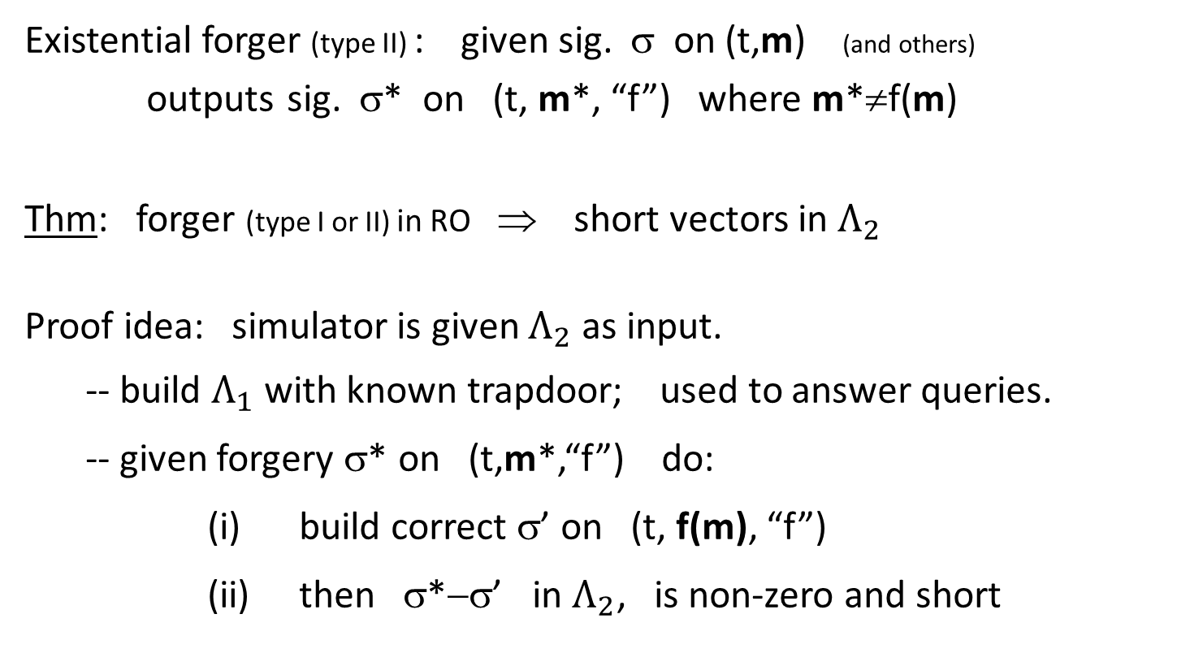
Unforgeabililty
Existential forger (type II) : given sig. σ on (t,m) (and others)
outputs sig. σ* on (t, m*, “f”) where m*≠f(m)
Thm: forger (type I or II) in RO ⇒ short vectors in $Λ_{2}$
Proof idea: simulator is given $Λ_{2}$ as input.
-- build $Λ_{1}$ with known trapdoor; used to answer queries.
-- given forgery σ* on (t,m*,“f”) do:
(i) build correct σ’ on (t, f(m), “f”)
(ii) then σ*−σ’ in $Λ_{2}$, is non-zero and short

Slide 22
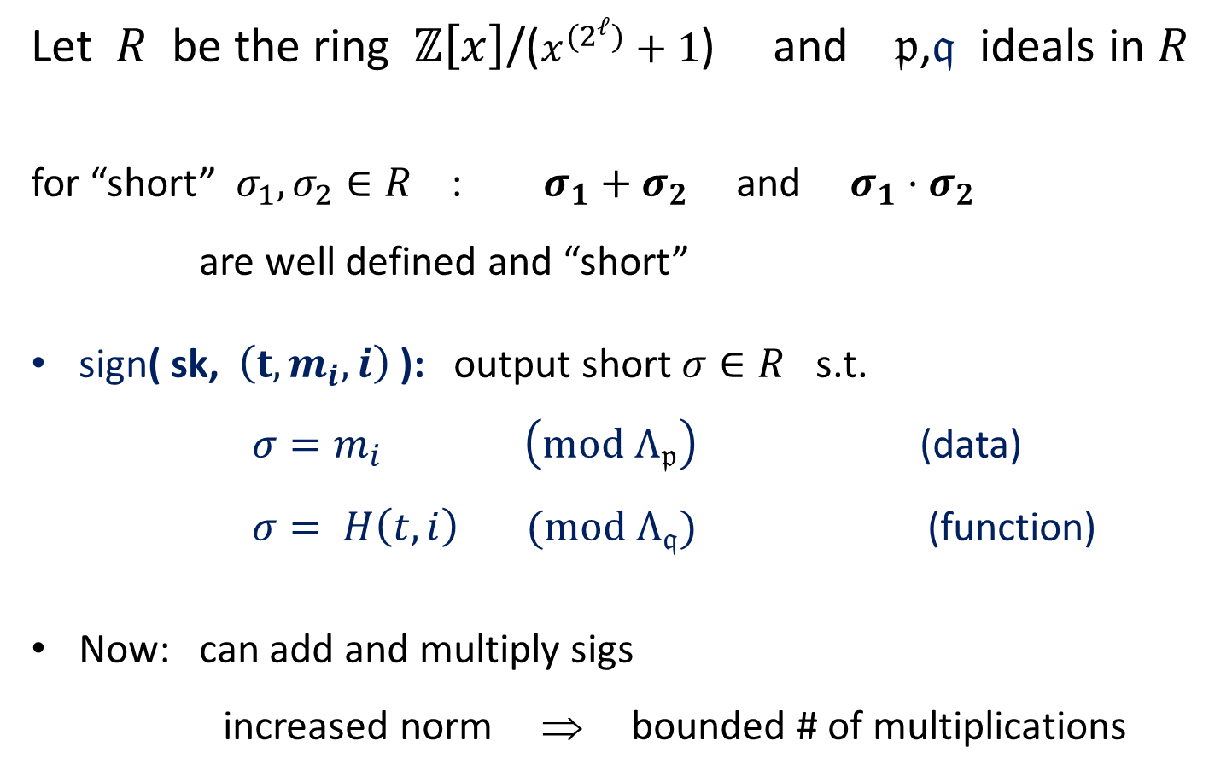
Polynomially homomorphic sigs
Let $R$ be the ring $ℤ\left[x\right]$/($x^{(2^{ℓ})}+1$) and $𝔭$,$𝔮$ ideals in $R$
for “short” $σ_{1},σ_{2}∈R$ : $σ_{1}+σ_{2}$ and $σ_{1}⋅σ_{2}$
are well defined and “short”
sign( sk, $\left(t, m_{i}, i\right)$ ): output short $σ∈R$ s.t.
  $σ=m_{i} \left(\text{mod} Λ_{𝔭}\right)$ (data)
  $σ= H\left(t,i\right) \text{(}\text{mod} Λ_{𝔮})$ (function)
Now: can add and multiply sigs
increased norm ⇒ bounded # of multiplications
But no privacy !

Slide 23
Summary
 | Encryption | Signatures
Linear functions | Large p: [P’99,…] Small p: [GM’82,…] | [KFM’04,CJL’06,BFKW’09] [BF’10]
Polynomials | quadratic: [BGN’05, GHV’10] small degree: [G’09] | [BF’11] (small degree)
Poly-size circuits | [G’09, …] | ????

Slide 24
Alternate approaches
Computationally Sound (CS) Proofs [Micali’00]
t, f: Y → X
m, t
sign( sk, (t, m) )
m, t
σ
x=f(m), proof π
π: short proof of knowledge [V’07] that
(t, f, x) ∈ { (t, f, x; m, σ) s.t. }
Need PCP machinery. Harder to compose [V’07]
Cannot build from falsifiable assumptions [GW’11]
x = f(m), and
verify(PK, (t,m), σ) = 1

Slide 25
Many open problems
Fully homomorphic sigs (a la Gentry’s bootstrapping)
  Or more than low-degree polynomials
Polynomially homomorphic sigs:
  with privacy
  without random oracles (can do for linear sigs)

Slide 26
THE END

Slide 27
Restricted Homomorphic Encryption
Back in 2008: best homomorphic systems --
  linear or quadratic operations
Prabhakaran and Rosulek [PR’08] :
  Built systems that provably support
  only linear operations.
More generally: can we build systems that support a restricted set of homomorphisms F ?

Slide 28
Applications [BSW’11]
Network guards on encrypted traffic:
With restricted FHE:
guard can implement policy, but nothing else
Goal: restricted FHE that keeps ciphertext size short
Guard 1
Guard 2

Slide 29

A New Construction [BSW’11]
Fully
Hom. Enc.
Hom. Enc.
for F
func. family F
Properties: no ciphertext expansion under
constant iteration
Tools: a recent short NIZK due to Groth [G’10]

