Slide 1
Secure Multiparty Computation and its Applications
Yuval Ishai
Technion

Slide 2
How much do we earn?
x₄
x₃
x₅
∑x_{i}
x₂
x₆
x₁
Goal: compute ∑x_{i} without revealing anything else

Slide 3
A better way?
x₄
m₃=m₂+x₃
m₄=m₃+x₄
x₃
x₅
m₂=m₁+x₂
m₅=m₄+x₅
m₆-r
x₂
x₆
m₁=r+x₁
m₆=m₅+x₆
x₁
Assumption: ∑x_{i}<M (say, M=10¹⁰)
(+ and – operations carried modulo M)
0≤r<M

Slide 4
A security concern
x₄
x₃
x₅
m₂=m₁+x₂
x₂
x₆
m₁
x₁

Slide 5
Resisting collusions
x₄
r₄₃
r₅₁
x₃
x₅
r₃₂
r₂₅
r₆₅
x₂
x₆
r₁₂
x₁
r₁₆
x_{i} + inbox_{i} - outbox_{i}

Slide 6
More generally
P₁,…,P_{n} want to securely compute f(x₁,…,x_{n})
Up to t parties can collude
Questions
When is this at all possible?
How efficiently?
Information-theoretic security possible when t<n/2 [BGW88,CCD88,RB89]
Computational security possible for any t (under standard cryptographic assumptions) [Yao86,GMW87,CLOS02]
Notes:
6

Slide 7
More generally
P₁,…,P_{n} want to securely compute f(x₁,…,x_{n})
Up to t parties can collude
Questions
When is this at all possible?
How efficiently?
Several efficiency measures: communication, computation, rounds
Until recently: communication grows linearly with circuit size f
[Gentry ’09]: dependence on circuit size can be eliminated!
Still wide open in information-theoretic setting
Notes:
7

Slide 8
Even more generally…
Functionality f mapping n inputs to n outputs
possibly randomized or reactive
Goal: t-secure protocol realizing f
Emulate an ideal evaluation of f using a trusted party
… even if up to t of the n parties can be corrupted
Variants:
Semi-honest vs. malicious corruptions
Honest majority (t<n/2) vs. no honest majority (t≥n/2)
Information-theoretic vs. computational security
Standlone vs. composable security
Adaptive vs. non-adaptive security
Different network models, setup assumptions
Notes:
8

Slide 9
MPC and the real world
Numerous motivating application scenarios
voting, bidding, matching, searching, data mining, gambling …
Several ongoing implementation projects
Jan 2008: “MPC gone live” in Denmark
Much room for efficiency improvements
Ideally: approach efficiency of insecure computation
No barriers in sight
Notes:
9

Slide 10
Rest of Talk
Connections between MPC and problems from other domains
motivate new questions
broaden application of techniques
Connections between different MPC variants
Disclaimer: small sample of examples, biased by own research

Slide 11
Applying MPC in Two-Party Cryptography

Slide 12
Back to the 1980s
Zero-knowledge proofs for NP [GMR85,GMW86]
Computational MPC with no honest majority [Yao86, GMW87]
Unconditional MPC with honest majority [BGW88, CCD88, RB89]
Unconditional MPC with no honest majority assuming ideal OT [Kilian88]
Are these unrelated?
S
R
(s₀,s₁)
c
x_{c}
Notes:
To remind ourselves what we are talking about, let’s recall why MPC might be have been considered dead long time ago.
… should we declare victory and move on?

Slide 13
Simplifies and unifies feasibility results
Improves asymptotic efficiency of ZK/2PC
MPC with honest majority
Next slides
ZK^{Com}/2PC^{OT}
Com/OT
protocols
ZK/2PC

Slide 14
A high level idea [IKOS07,IPS08]:
Run MPC “in the head”.
Commit to virtual views.
Use consistency checks to ensure honest majority.

Slide 15
Zero-Knowledge Proofs
Goal: ZK proof for a relation R(x,w)
Towards using MPC:
define n-party functionality g(x; w₁,...,w_{n}) = R(x, w₁⊕...⊕ w_{n})
use any 2-secure, perfectly correct protocol for g
security in semi-honest model
honest majority when n>4
Notes:
Why should Alice be happy? This has similar advantages to the use of secure point-to-point channels in Bernard’s world.
… But it is still unclear why Bernard’s MPC protocols for the case of an honest majority are relevant.

Slide 16
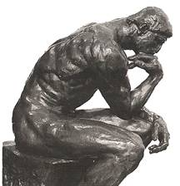
MPC ➔ ZK [IKOS07]
Given MPC protocol π for g(x; w₁,...,w_{n}) = R(x, w₁⊕...⊕ w_{n})
P₁
P₂
V₁
w₁
V₂
w₂
w
w=w₁⊕...⊕ w_{n}
π
w_{n}
views
P_{n}
V_{n}
V₃
w₃
P₃
V₅
w₅
V₄
w₄
P₅
P₄
Prover
Verifier
commit to views V₁,...,V_{n}
random i,j
accept iff output=1 & V_{i},V_{j} are consistent
open views V_{i}, V_{j}
Notes:
16
Each setting requires own set of tools/techniques

Slide 17
Extensions
Works also with OT-based MPC
Variant: use 1-secure MPC
Commit to views of parties + channels
Open one view and one incident channel
Handle MPC with error via coin-flipping
Better soundness via t-robust MPC
Notes:
Simplicity: still hard to teach in class, little connection between results. Compare with PCP theorem.
Theoretical efficiency: why should we care?
This talk will explain this.

Slide 18
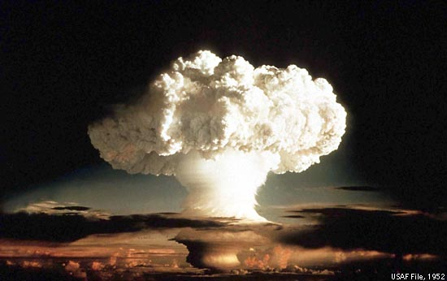
Communication Complexity
Gentry ‘09
Notes:
But somewhat surprisingly, most lifeforms that existed prior to the bomb seem to be alive and well.

Slide 19
Information-Theoretic MPC
y₁
y₅
n parties
n-argument function f
y₂
y₄
y₃
Communication complexity: learn f (y₁,y₂,…,y_{n})
Secure multiparty computation: learn only f (y₁,y₂,…,y_{n})
Notes:
Start with peter winkler’s example, then discuss dependence on circuit size (with picture from IK04), then say that resolving this question
will have a very significant application that doesn’t talk about privacy.

Slide 20
Big Open Question
Ben-Or, Goldwasser, Wigderson, 1988
Chaum, Crépeau, Damgård, 1988
Beaver, Micali, Rogaway, 1990
B, Feigenbaum, Kilian, R., 1990
Information-theoretic MPC is feasible!
Open question:
n≥3 players can compute any function f of their inputs with total work ≈ circuit-size
Can n computationally unbounded players compute an arbitrary f with communication ≈ input-length?
“Fully homomorphic encryption of information-theoretic cryptography”
Notes:
This is the fully homomorphic encryption of i.t. cryptography

Slide 21
Question Reformulated
Is the communication complexity of MPC strongly correlated with the computational complexity of the function being computed?
All functions
efficiently
computable
functions
= communication-efficient MPC
= no communication-efficient MPC

Slide 22
Locally Decodable Codes
m
c
i
Simultaneously provide:
robustness
local (randomized) decoding
Big open question: minimize length

Slide 23
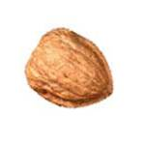
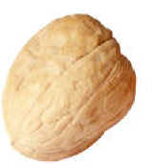
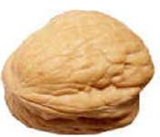
[IK04]
[KT00]
MPC
PIR
LDC
1990
1995
2000
MPC and LDC are closely related
Rough idea: m = truth-table of f, c = truth-table of MPC
Privacy of MPC ➔ “smooth” decoding ➔ robustness
New LDCs [Yek07,Efr09] ➔ better MPC for “hard” f
Open: better MPC for moderately hard f
Motivates new LDC questions
Notes:
Equivalent in the sense that a big breakthrough on one problem will imply a similar breakthrough in the others. If you want to prove strong lower bounds on MPC, this will imply LDC lower bounds.

Slide 24
Round Complexity
Notes:
Start by saying: simple functions require few rounds to evaluate. What do we mean by simple?
show 3 pictures of MPC model: MPC, OT-based 2-PC, FKN [say that in the latter two cases we have equivalence]
For each model we have a class of functions that are “easy”. But most functions do not belong to this class.
What do we do?
Show a simple and generic application for delegating computations.

Slide 25
“Simple” functions require few rounds
NC⁰ functions
Output locality c

Slide 26
Randomized Encoding of Functions [Yao86,…,IK00,AIK04]
Dec(g(x,r)) = f(x)
x
f
y
Sim(f(x)) ≡ g(x,r)
decoder
simulator
x
g
Enc(y)
Enc(y)
r
g is a “randomized encoding” of f
Nontrivial relaxation of computing f
Hope: g can be “simple”
Achievable via MPC techniques
Notes:
Our key idea is to replace the cryptographic function f with a related function g, taking the original input of f and an additional random input, such that the output of g on input x and a uniformly random r is a randomized encoding of f(x). More specifically, we require that given g(x,r) one can decond f(x), and given f(x) one can simulate the distriution g(x,r) even without knowing x. We refer to g as a randomized encoding of f.
To be useful in our context this type of encoding should be on one hand secure, in the sense that, … and on the other hand liberal enough…
Note that if g is much easier than f, then moving from g to f must be complex.
We now define our notion of randomized encoding in more detail.

Slide 27
Cryptography in NC⁰ [AIK04]
OWF
OWF
Notes:
Our key idea is to replace the cryptographic function f with a related function g, taking the original input of f and an additional random input, such that the output of g on input x and a uniformly random r is a randomized encoding of f(x). More specifically, we require that given g(x,r) one can decond f(x), and given f(x) one can simulate the distriution g(x,r) even without knowing x. We refer to g as a randomized encoding of f.
To be useful in our context this type of encoding should be on one hand secure, in the sense that, … and on the other hand liberal enough…
Note that if g is much easier than f, then moving from g to f must be complex.
We now define our notion of randomized encoding in more detail.

Slide 28
Computational Complexity

Slide 29
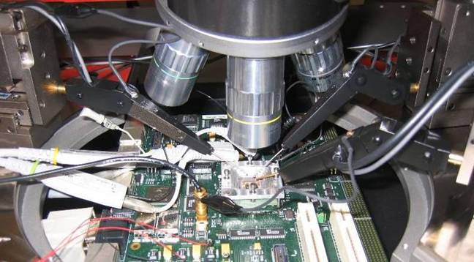
Private Circuits [ISW03,…]
AES(s,m)
AES(s,m)
s
s’
m
m

Slide 30
MPC on Silicon
output
S₁
S₂
Non-standard goal:
Maximize resilience/size ratio
Many tiny parties!
S₃
Challenge 1: Improve complexity and leakage rate [Ajt11]
Challenge 2: Extend leakage model [FRRTV10,GR10,JV10,…]
input

Slide 31
Concluding Remarks
MPC is an exciting research area
Many connections with other problems
Inherits depth from related problems
Motivates new theoretical questions
Motivated by practical applications
Notes:
31

