Slide 1
Abstraction-Guided Synthesis
Martin Vechev
Eran Yahav
Greta Yorsh
IBM Research

Slide 2
Challenge: Correct and Efficient Synchronization
P1()
P2()
P3()
{
……………………………
…………………….
…
}
{
………………
……
………………….
…………………….
…………………………
}
{
…………………..
……
…………………….
………………
……………………
}
atomic
atomic
atomic
Safety Specification: S

Slide 3
Challenge: Correct and Efficient Synchronization
P1()
P2()
P3()
{
……………………………
…………………….
…
}
{
………………
……
………………….
…………………….
…………………………
}
{
…………………..
……
…………………….
………………
……………………
}
Safety Specification: S

Slide 4
Challenge
Assumption: serial executions satisfy the specification
Find minimal synchronization that makes the program satisfy the specification
Avoid all bad interleaving while permitting as many good interleavings as possible
Handle infinite-state programs

Slide 5
Our Approach
Synthesis of synchronization via abstract interpretation
Compute over-approximation of all possible program executions
Add minimal atomics to avoid (over approximation of) bad interleavings
Interplay between abstraction and synchronization
Finer abstraction may enable finer synchronization
Coarse synchronization may enable coarser abstraction

Slide 6
Standard Approach: Abstraction Refinement
program
Valid
specification
Abstract
counter example
Abstract
counter example
Verify
abstraction

Abstraction Refinement
Change the abstraction to match the program

Slide 7
Our Approach: Abstraction-Guided Synthesis
program
ϕ
P’
Program Restriction
Implement
specification
Abstract counter example
Abstract
counter example
Verify
abstraction

Abstraction Refinement
Change the program to match the abstraction
Notes:
Notes:
- Should say here --- could have many solutions, implement is picking one based on quantitative criterion

Slide 8
AGS Algorithm – High Level
Input: Program P, Specification S, Abstraction 
Output: Program P’ satisfying S under 
ϕ = true
while(←P→ ∩ ←ϕ→  S) {
select π ∈ (←P→ ∩ ←ϕ→) and π  S
if (?) {
ϕ = ϕ ∧ avoid(π)
} else {
 = refine(, π)
}
}
return implement(P,ϕ)

Slide 9
Avoiding an interleaving
By adding atomicity constraints
Atomicity predicate [l1,l2] – no context switch allowed between execution of statements at l1 and l2
avoid(π)
A disjunction of all possible atomicity predicates that would prevent π
Example
π = A₁ B₁ A₂ B₂
avoid(π) = [A₁,A₂]  [B₁,B₂]
(abuse of notation)

Slide 10
Example
T1
1: x += z
2: x += z
T2
1: z++
2: z++
T3
1: y1 = f(x)
2: y2 = x
3: assert(y1 != y2)
f(x) {
if (x == 1) return 3
else if (x == 2) return 6
else return 5
}

Slide 11
Example: Parity Abstraction
y1
y1
6
6
5
5
4
4
3
3
2
2
1
1
0
1
2
3
4
y2
0
1
2
3
4
y2
Concrete values
Parity abstraction (even/odd)

Slide 12
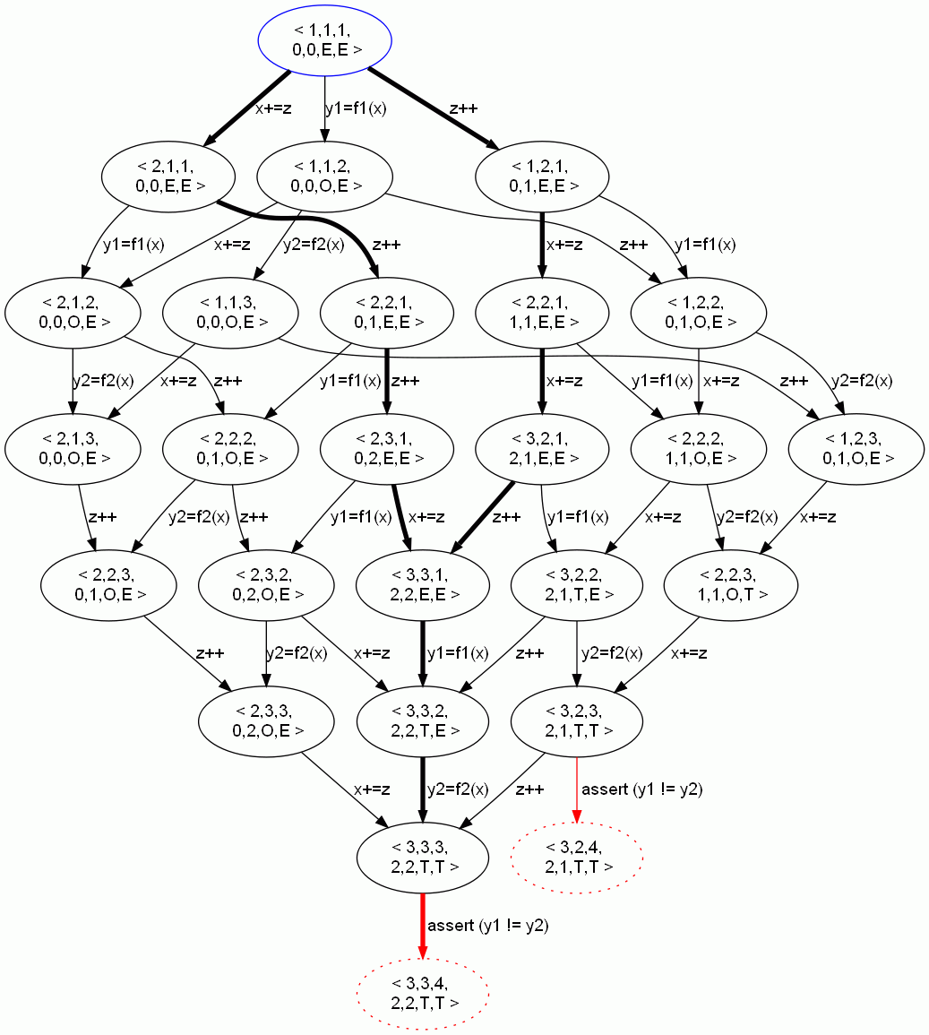
Example: Avoiding Bad Interleavings
ϕ = true
while(←P→ ∩ ←ϕ→  S) {
select π ∈ (←P→ ∩ ←ϕ→) and π  S
if (?) {
ϕ = ϕ ∧ avoid(π)
} else {
 = refine(, π)
}
}
return implement(P,ϕ)
avoid(π₁) = [z++,z++]
ϕ = [z++,z++]
ϕ = true

Slide 13
Example: Avoiding Bad Interleavings
ϕ = true
while(←P→ ∩ ←ϕ→  S) {
select π ∈ (←P→ ∩ ←ϕ→) and π  S
if (?) {
ϕ = ϕ ∧ avoid(π)
} else {
 = refine(, π)
}
}
return implement(P,ϕ)
avoid(π₂) =[x+=z,x+=z]
ϕ = [z++,z++]
ϕ = [z++,z++]∧[x+=z,x+=z]

Slide 14
Example: Avoiding Bad Interleavings
ϕ = true
while(←P→ ∩ ←ϕ→  S) {
select π ∈ (←P→ ∩ ←ϕ→) and π  S
if (?) {
ϕ = ϕ ∧ avoid(π)
} else {
 = refine(, π)
}
}
return implement(P,ϕ)
T1
1: x += z
2: x += z
T2
1: z++
2: z++
T3
1: y1 = f(x)
2: y2 = x
3: assert(y1 != y2)
ϕ = [z++,z++]∧[x+=z,x+=z]

Slide 15
Example: Avoiding Bad Interleavings
parity
y1

parity
✗
parity
✓
T1
x+=z; x+=z
6
T1
x+=z; x+=z
6
T1
x+=z; x+=z
6
5
5
5
T2
z++;
z++;
4
T2
z++;
z++;
4
T2
z++;
z++;
4
3
3
3
T3
y1=f(x)
y2=x
assert
y1!= y2
T3
y1=f(x)
y2=x
assert
y1!= y2
T3
y1=f(x)
y2=x
assert
y1!= y2
2
2
2
1
1
1
0
1
2
3
4
y2
0
1
2
3
4
0
1
2
3
4
But we can also refine the abstraction…

Slide 16
parity
y1
✗
parity
✗
parity
✓
T1
x+=z; x+=z
6
T1
x+=z; x+=z
6
T1
x+=z; x+=z
6
5
5
5
T2
z++;
z++;
4
T2
z++;
z++;
4
T2
z++;
z++;
4
3
3
3
T3
y1=f(x)
y2=x
assert
y1!= y2
T3
y1=f(x)
y2=x
assert
y1!= y2
T3
y1=f(x)
y2=x
assert
y1!= y2
2
2
2
1
1
1
(a)
0
1
2
3
4
y2
(b)
0
1
2
3
4
(c)
0
1
2
3
4
interval
✗
interval
✓
T1
x+=z; x+=z
6
T1
x+=z; x+=z
6
5
5
T2
z++;
z++;
4
T2
z++;
z++;
4
3
3
T3
y1=f(x)
y2=x
assert
y1!= y2
2
T3
y1=f(x)
y2=x
assert
y1!= y2
2
1
1
(d)
0
1
2
3
4
(e)
0
1
2
3
4
octagon
✗
octagon
✓
T1
x+=z; x+=z
6
T1
x+=z; x+=z
6
5
5
T2
z++;
z++;
4
T2
z++;
z++;
4
3
3
T3
y1=f(x)
y2=x
assert
y1!= y2
2
T3
y1=f(x)
y2=x
assert
y1!= y2
2
1
1
(f)
0
1
2
3
4
(g)
0
1
2
3
4

Slide 17
Quantitative Synthesis
Performance: smallest atomic sections
Interval abstraction for our example produces the atomicity constraint: ([x+=z,x+=z] ∨ [z++,z++]) ∧ ([y1=f(x),y2=x] ∨ [x+=z,x+=z] ∨ [z++,z++])
Minimal satisfying assignments
₁ = [z++,z++]
₂ = [x+=z,x+=z]

Slide 18
AGS Algorithm – More Details
Forward Abstract Interpretation, taking ϕ into account for pruning non-feasible interleavings
Input: Program P, Specification S, Abstraction 
Output: Program P’ satisfying S under 
ϕ = true
while(←P→ ∩ ←ϕ→  S) {
select π ∈ (←P→ ∩ ←ϕ→) and π  S
if (?) {
ϕ = ϕ ∧ avoid(π)
} else {
 = refine(, π)
}
}
return implement(P,ϕ)
Up to this point did not commit to an implementation mechanism
Backward Exploration of Invalid Interleavings.
Using ϕ to prune non-feasible interleavings.
Order of selection might matter
Choosing between Abstraction Refinement / Program Restricton.
Refinement not always possible
avoidance not always possible (e.g., serial interleaving)
may try and backtrack
Notes:
Notes:
In general, both “avoid” and “implement” are pluggable procedures
Language of constraints may need to be adapted though

Slide 19
Implementability
Separation between schedule constraints and how they are realized
Can realize in program: atomic sections, locks,…
Can realize in scheduler: benevolent scheduler
T1
1: while(*) {
2: x++
3: x++
4: }
T2
1: assert (x != 1)
No program transformations (e.g., loop unrolling)
Memoryless strategy

Slide 20
Examples Intuition
If can show disjoint access can avoid synchronization
Requires abstractions rich enough to capture access pattern to shared data
Parity
Intervals

Slide 21
Example: “Double Buffering”
Render
Fill
fill() {
L1:if (i < N) {
L2:Im[Fill][i] = read();
L3: i += 1;
L4: goto L1;
}
L5: Fill ˆ= 1;
L6: Render ˆ= 1;
L7: i = 0;
L8: goto L1;
}
render() {
L1:if (j < N) {
L2: write(Im[Render][j]);
L3: j += 1;
L4: goto L1;
}
L5: j = 0;
L6: goto 1;
}
int Fill = 1;
int Render = 0;
int i = j = 0;
main() {
fill() || render();
}

Slide 22
Experimental Results
Simplified versions of
Double buffering
Defragmentation
…
Program | Refine Steps | Avoid Steps
Double buffering | 1 | 2
Defragmentation | 1 | 8
3D array update | 2 | 23
Array Removal | 1 | 17
Array Init | 1 | 56

Slide 23
Summary
An algorithm for Abstraction-Guided Synthesis
Synthesize efficient and correct synchronization
Refine the abstraction and/or restrict program behavior
Interplay between abstraction and syncrhonization
Quantitative Synthesis
Separate characterization of solution from choosing optimal solutions (e.g., smallest atomic sections)
Handles infinite-state systems
Based on abstract interpretation
In the near future – more abstract domains…

Slide 24
Invited Questions
Why atomic sections?
Why not start from the most constrained program and work downwards (relaxing constraints)?
Can’t you solve the problem purely by brute force search of all atomic section placements?
Why use only a single CEX at a time? Could use information about the whole (abstract) transition system?
Is this related to supervisor synthesis?

